Slide 1
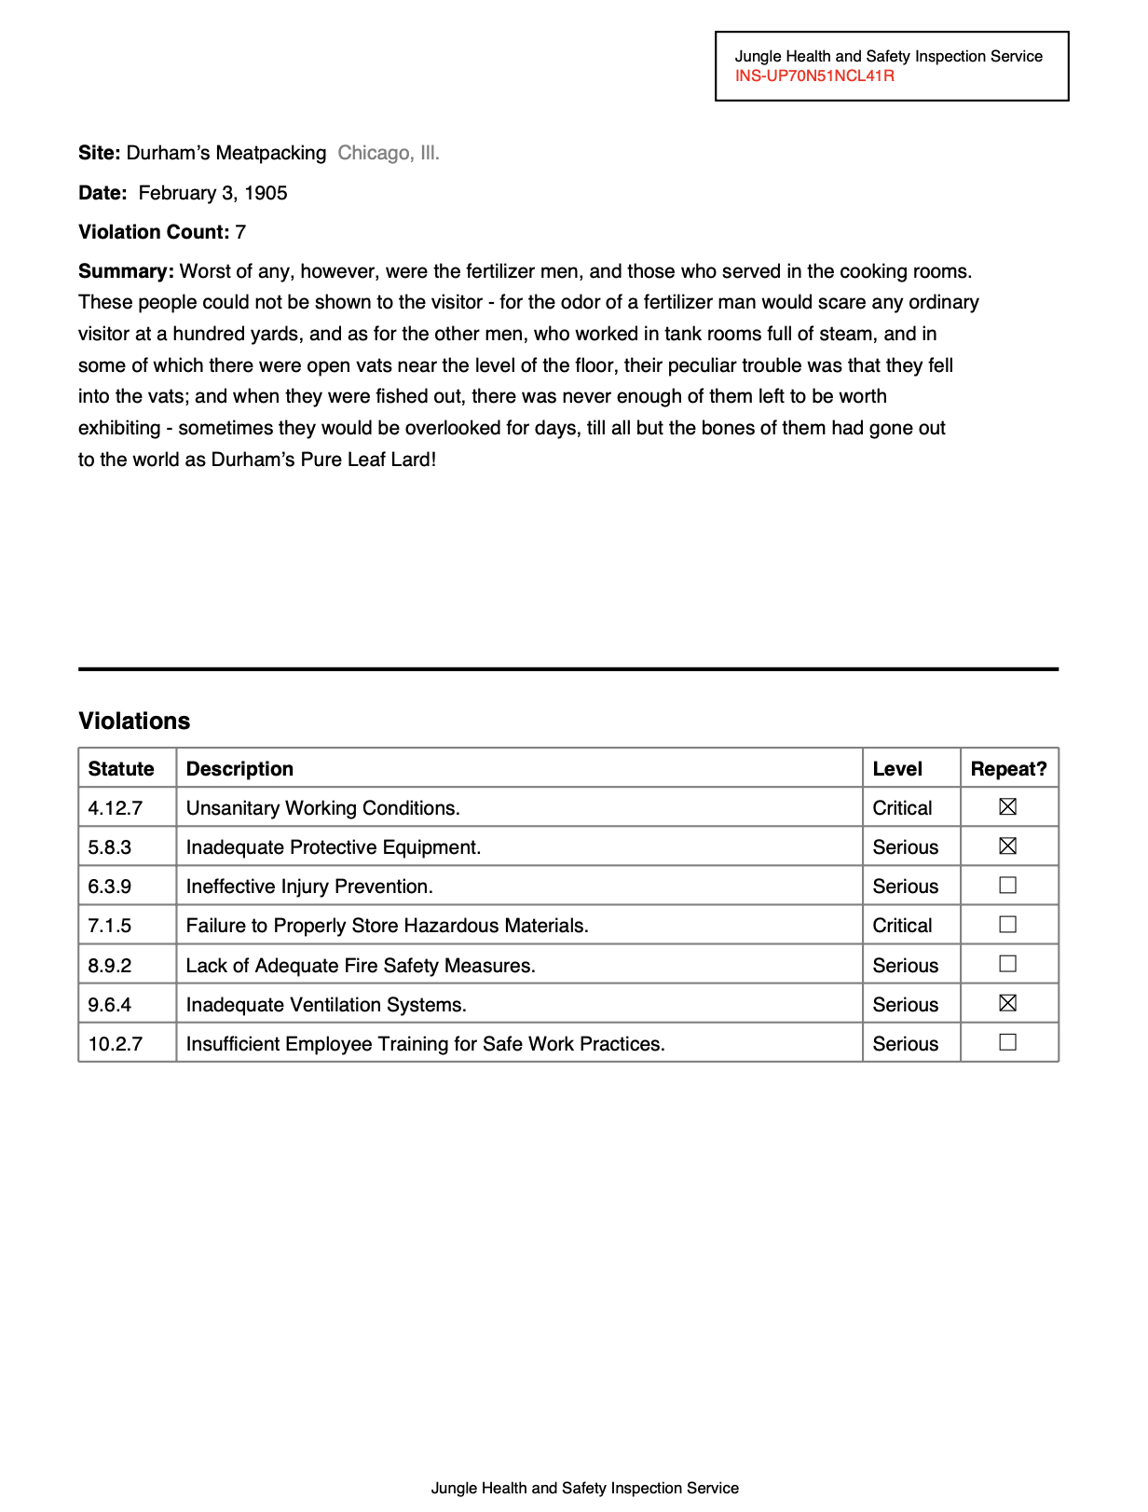
Visit https://bit.ly/abraji-pdfs, scroll down down down down down
Interviewing the worst PDFs on the planet
Jonathan Soma
Knight Chair in Data Journalism
Columbia University
js4571@columbia.edu / @dangerscarf

Slide 2
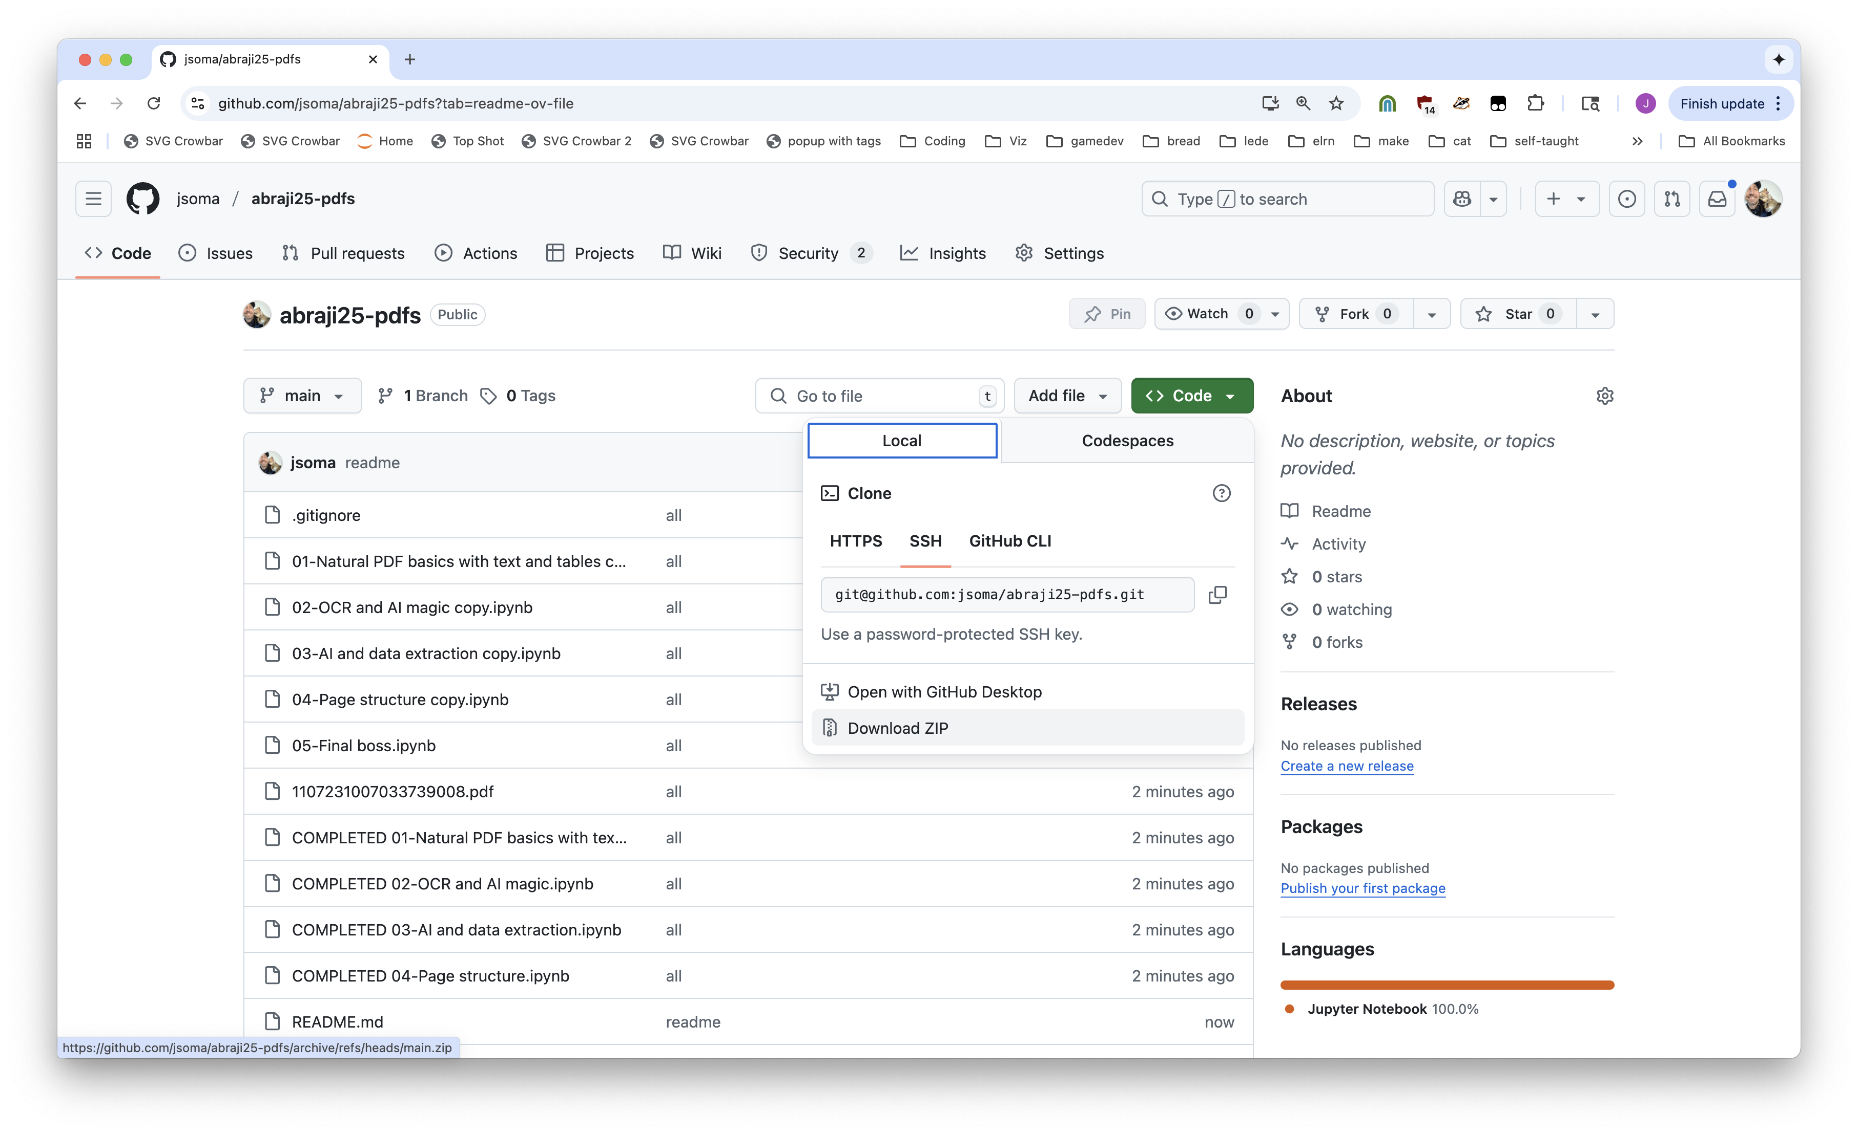


Visit https://bit.ly/abraji-pdfs, scroll down down down down down

Slide 3
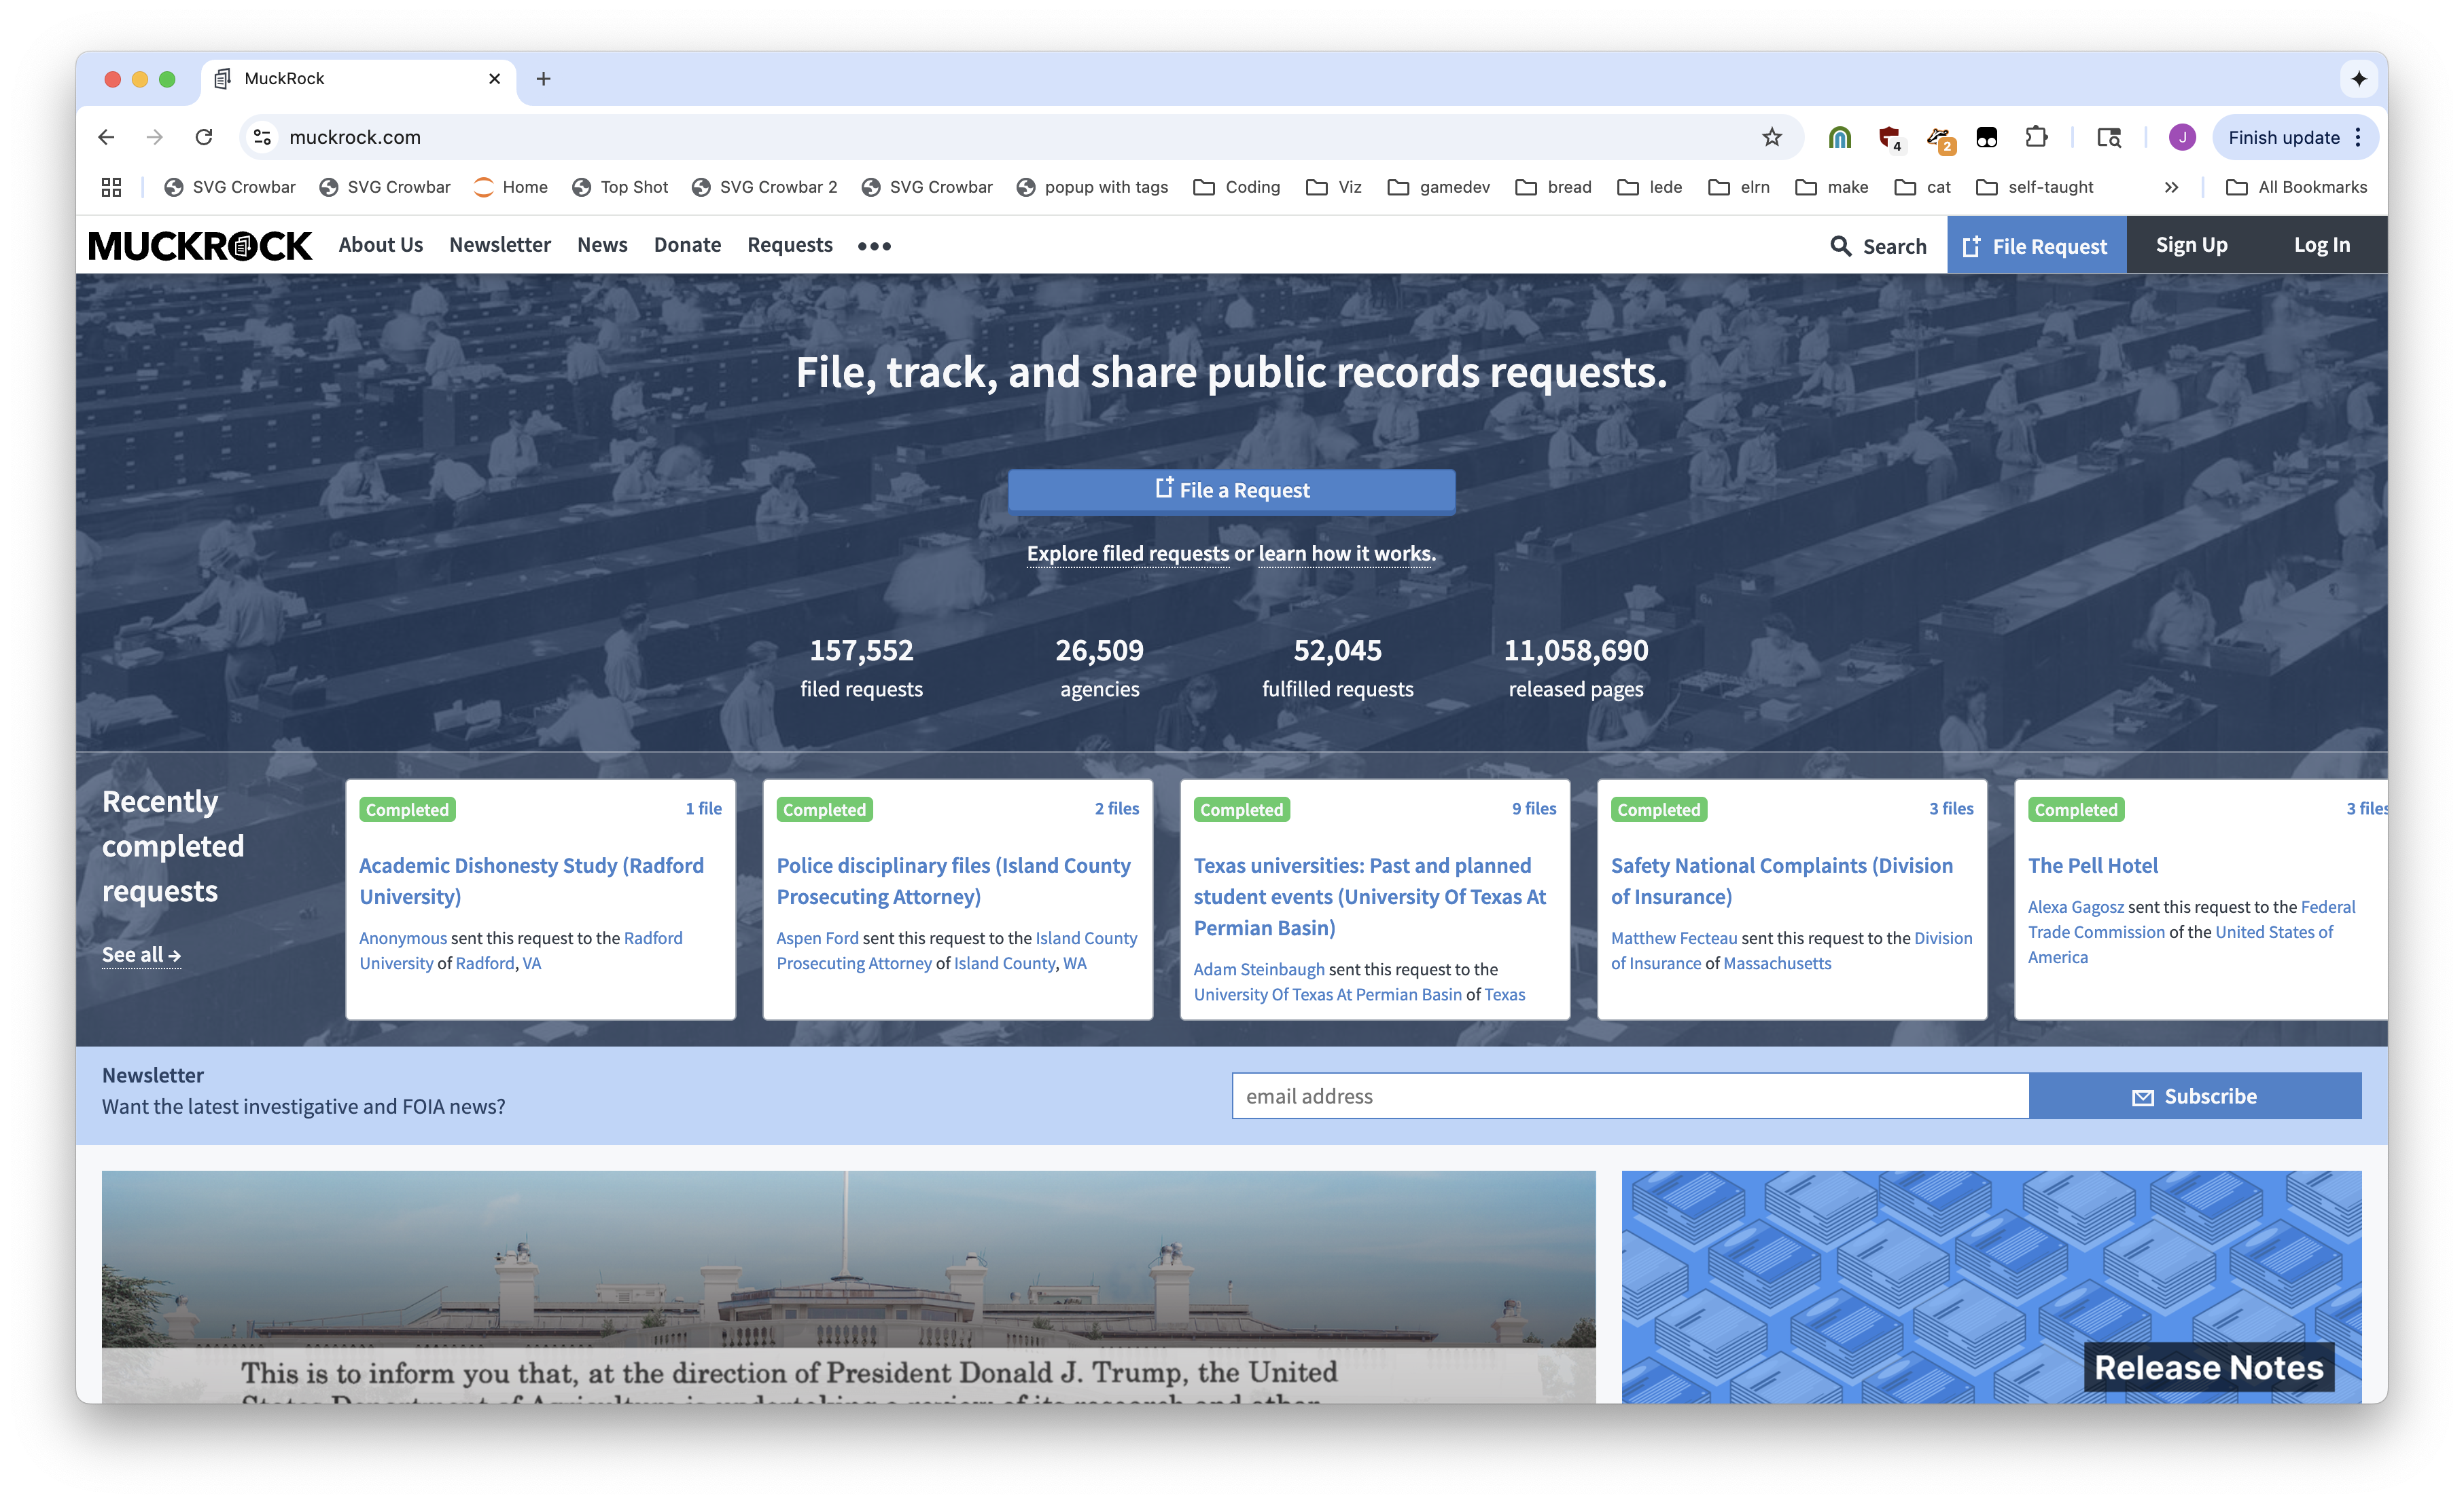
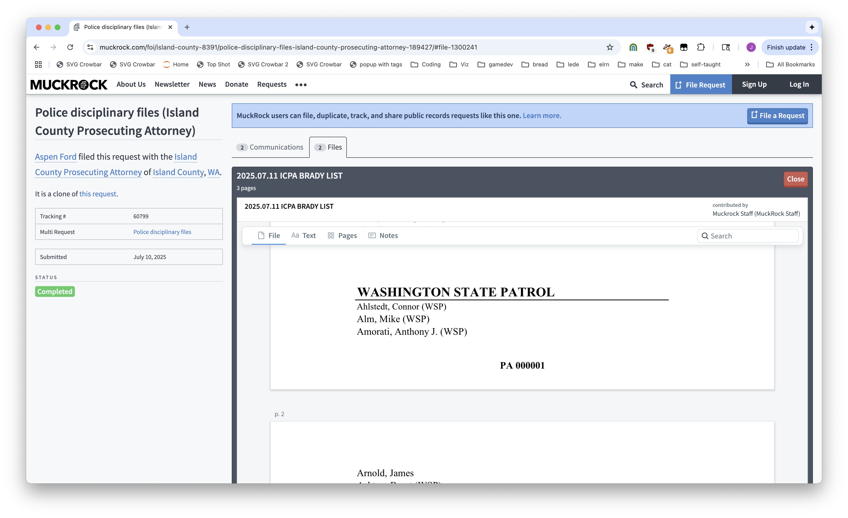
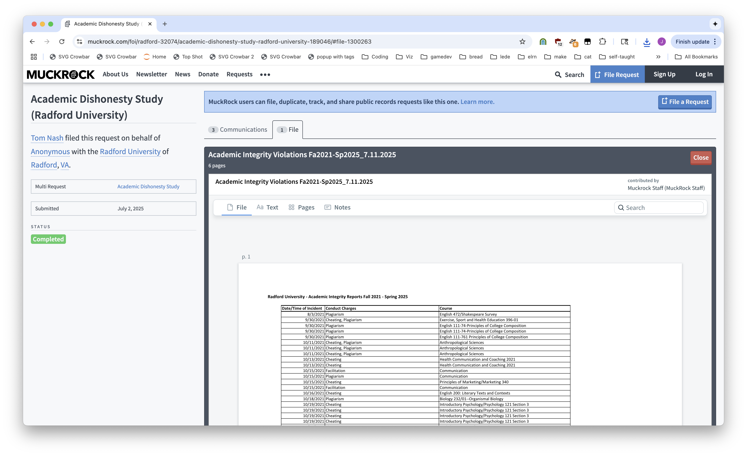
Notes:
Muckrock: a place for FOIA requests

Slide 4
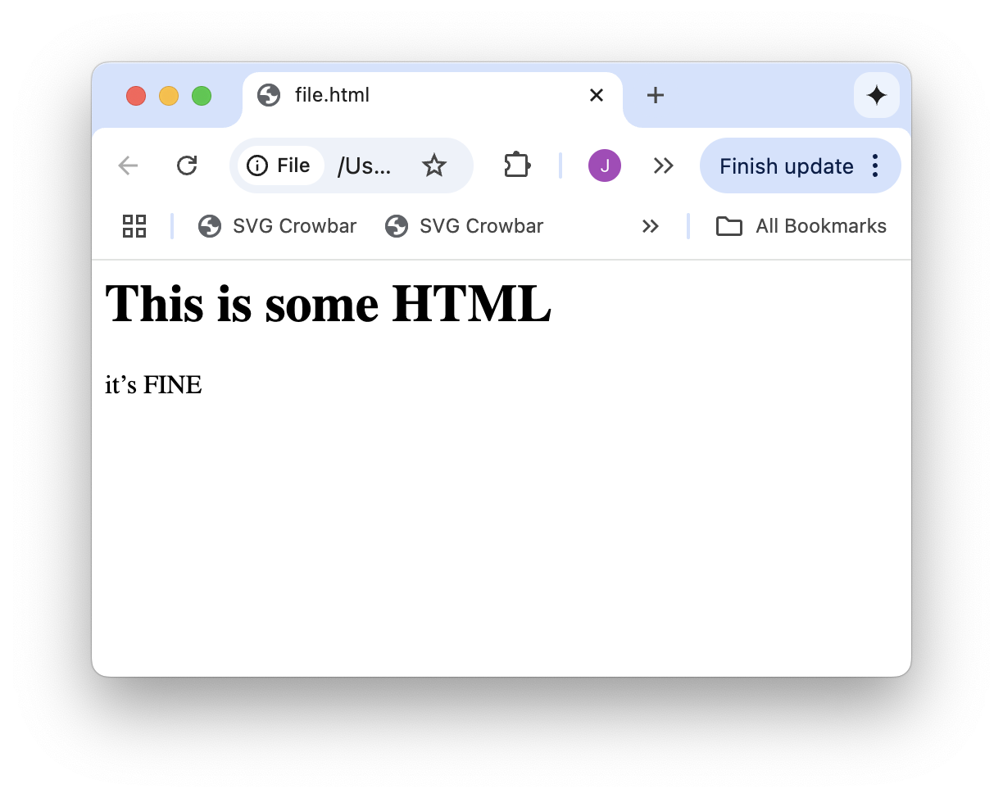
<h1>This is some HTML</h1>
<p>it’s FINE</h2>

Slide 5
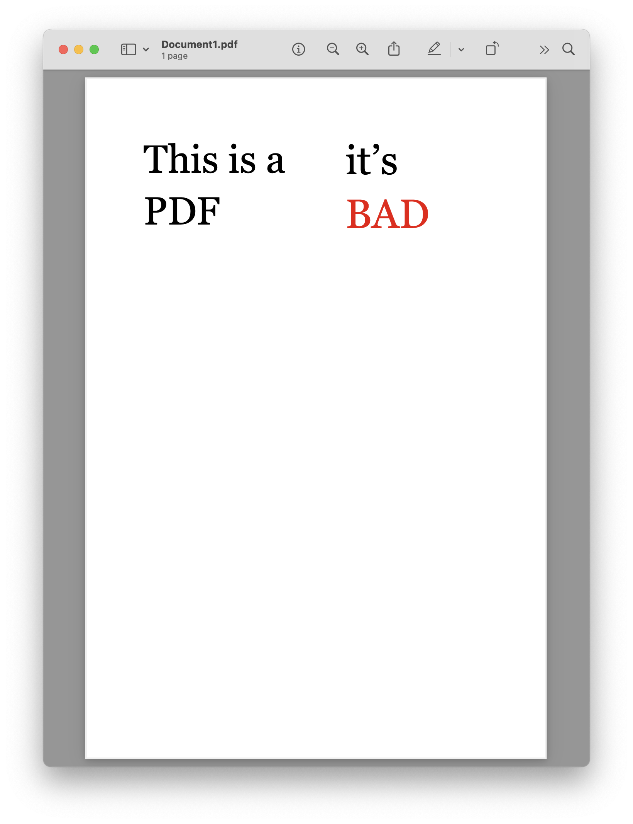

Slide 6
T
h
i
s
i
s
a
i
t
’
s
P
D
F
B
A
D

Slide 7

T
h
i
s
i
s
a
i
t
’
s
P
D
F
B
A
D
Notes:
PDFs are good for printing, but nothing else

Slide 8



matrix: (24.96, 0.0, 0.0, 24.96, 160.080072, 359.47999999999996)
fontname: AAAAAC+Georgia
adv: 0.293
upright: True
x0: 160.080072
y0: 354.01375999999993
x1: 167.393352
y1: 378.97375999999997
width: 7.313279999999992
height: 24.960000000000036
size: 24.960000000000036
mcid: None
tag: None
object_type: char
ncs: ICCBased
text: i
stroking_color: None
stroking_pattern: None
non_stroking_color: (0, 0, 0)
non_stroking_pattern: None
i
t
’
s
B
A
D
object_type: rect
width: 500
height: 1
Notes:
PDFs are good for printing, but nothing else

Slide 9
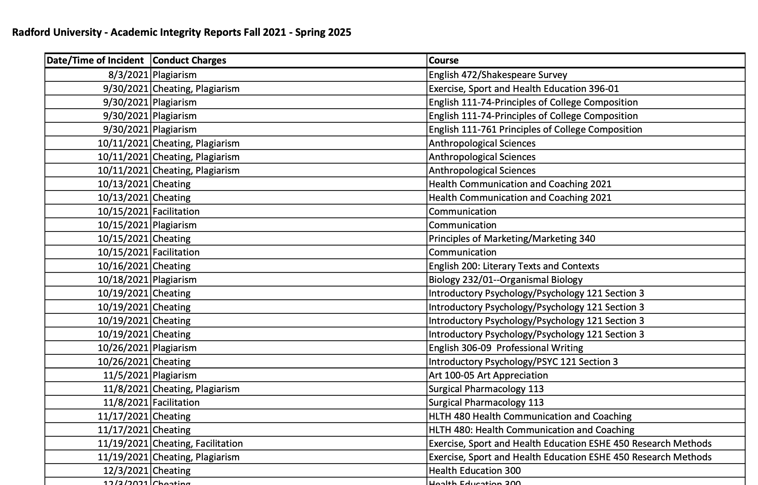
T
h
i
s
i
s
a
i
t
’
s
P
D
F
B
A
D

Slide 10
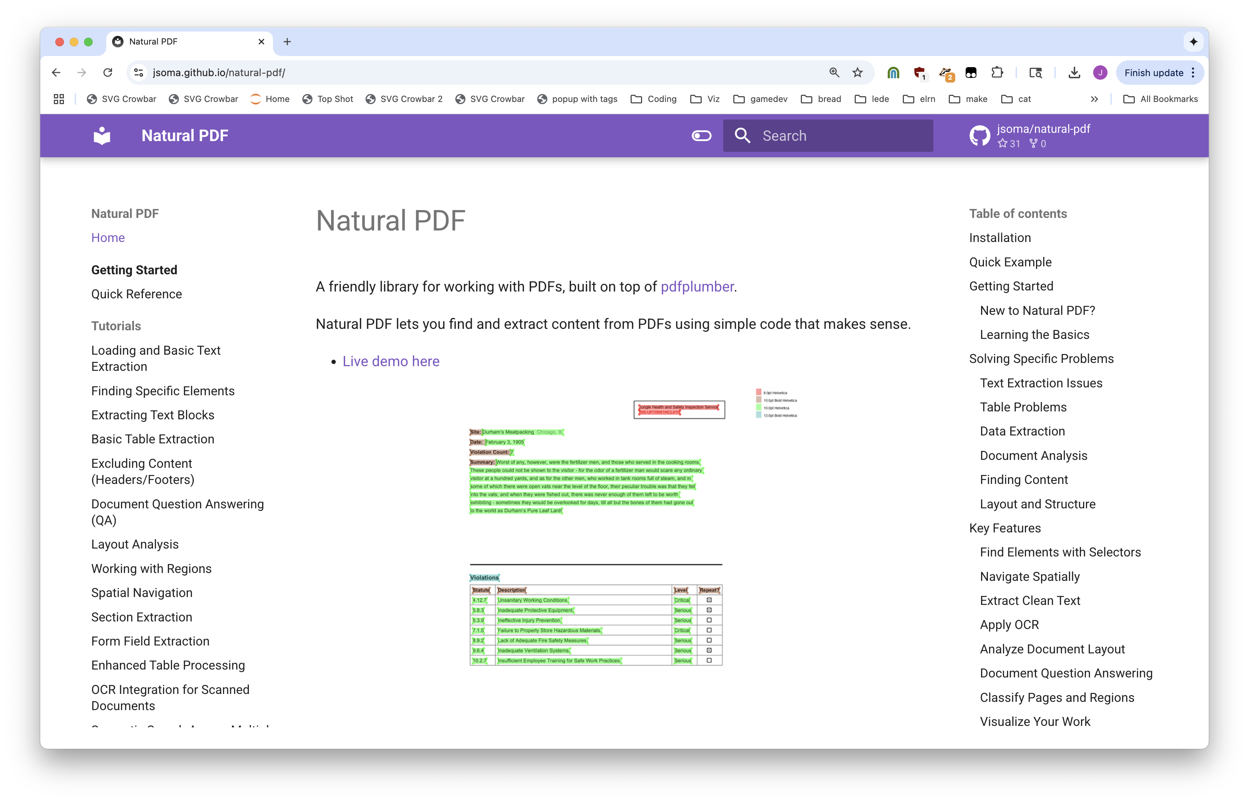

Slide 11
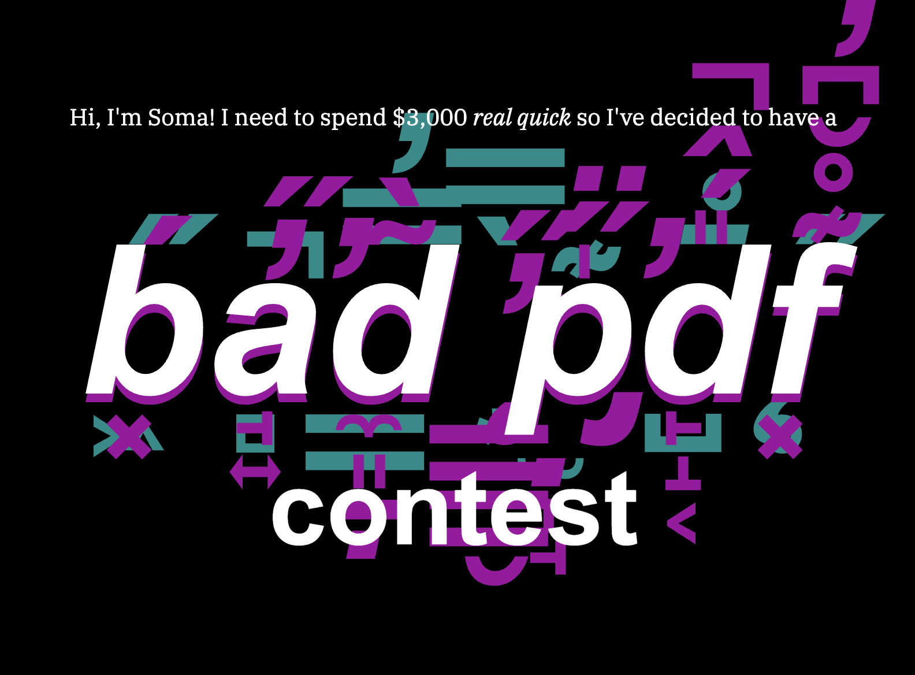
Notes:
I had a contest

Slide 12
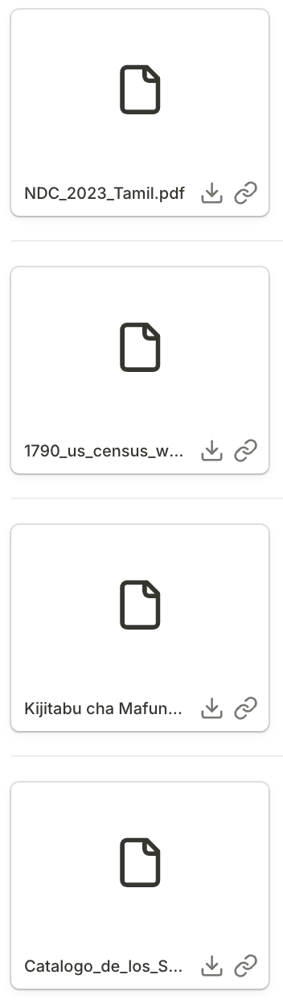
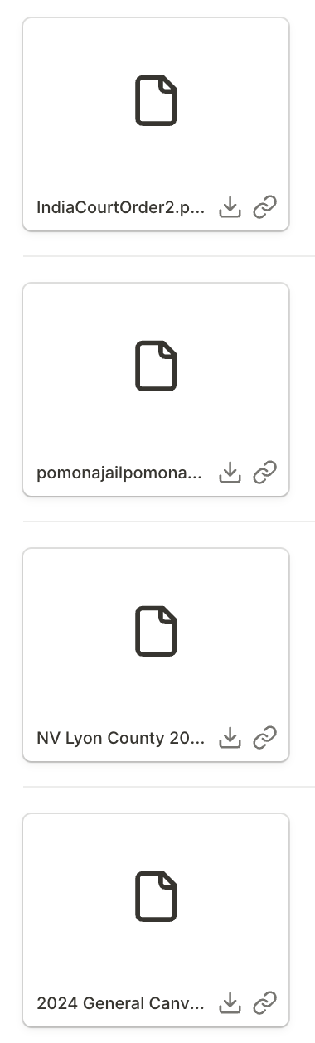
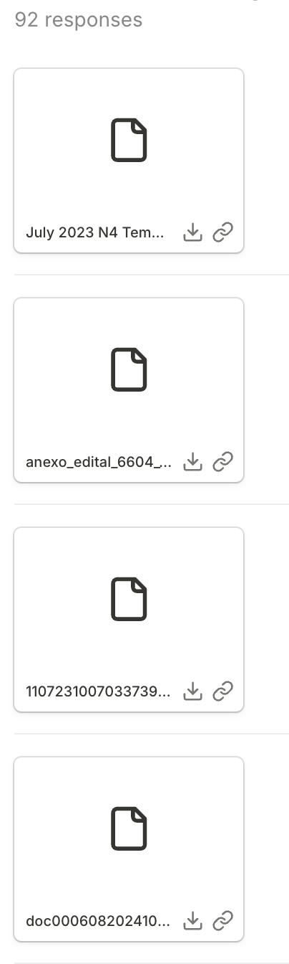
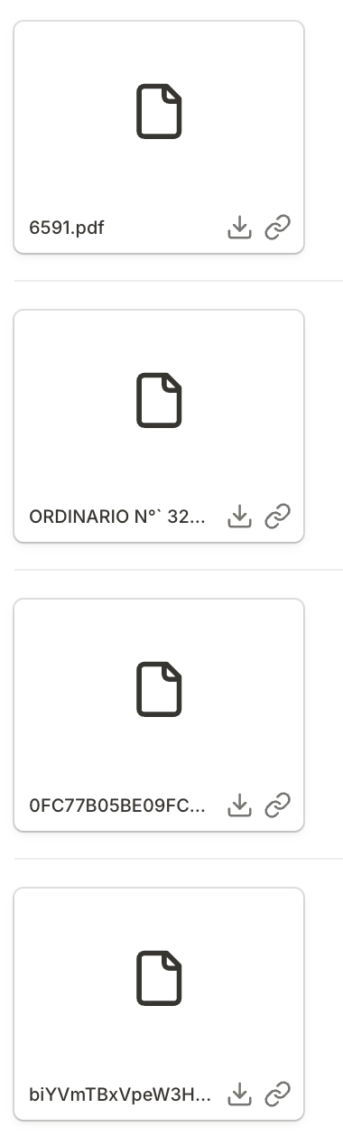
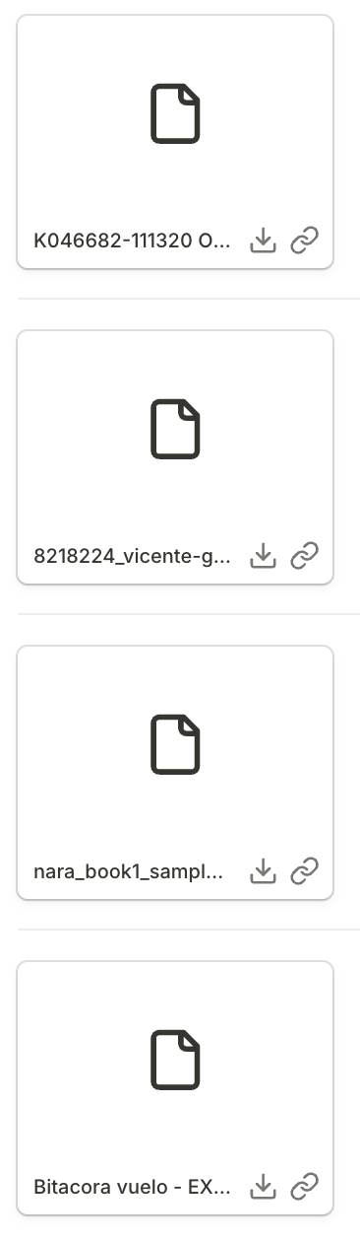

Slide 13
Let’s interview some PDFs.

Slide 14
Some reasons pdfs are bad, or things you might want to do with them
A quick look: You’re too lazy to open them
Searching: There are too many pages or documents, and you just need one answer
Extraction: You need to analyze 10,000 PDFs the exact same way
OCR: It isn’t text, it’s pictures of text!
Advanced OCR: It isn’t even nice pictures, it’s handwriting!
Table extraction: We don’t just want text, we want a spreadsheet

Slide 15
How we are going to structure this session
First half
Second half
How to use existing tools and techniques to get the data we want from most kinds of PDFs
How to use powerful, custom tools to get data from the worst PDFs on the planet

Slide 16
Google is amazing at this
Notebook LM
Pintpoint
AI Studio

Slide 17
Why can’t we just ask an LLM?
We can, kind of
KIND OF.
Kind of not? But kind of yes.

Slide 18
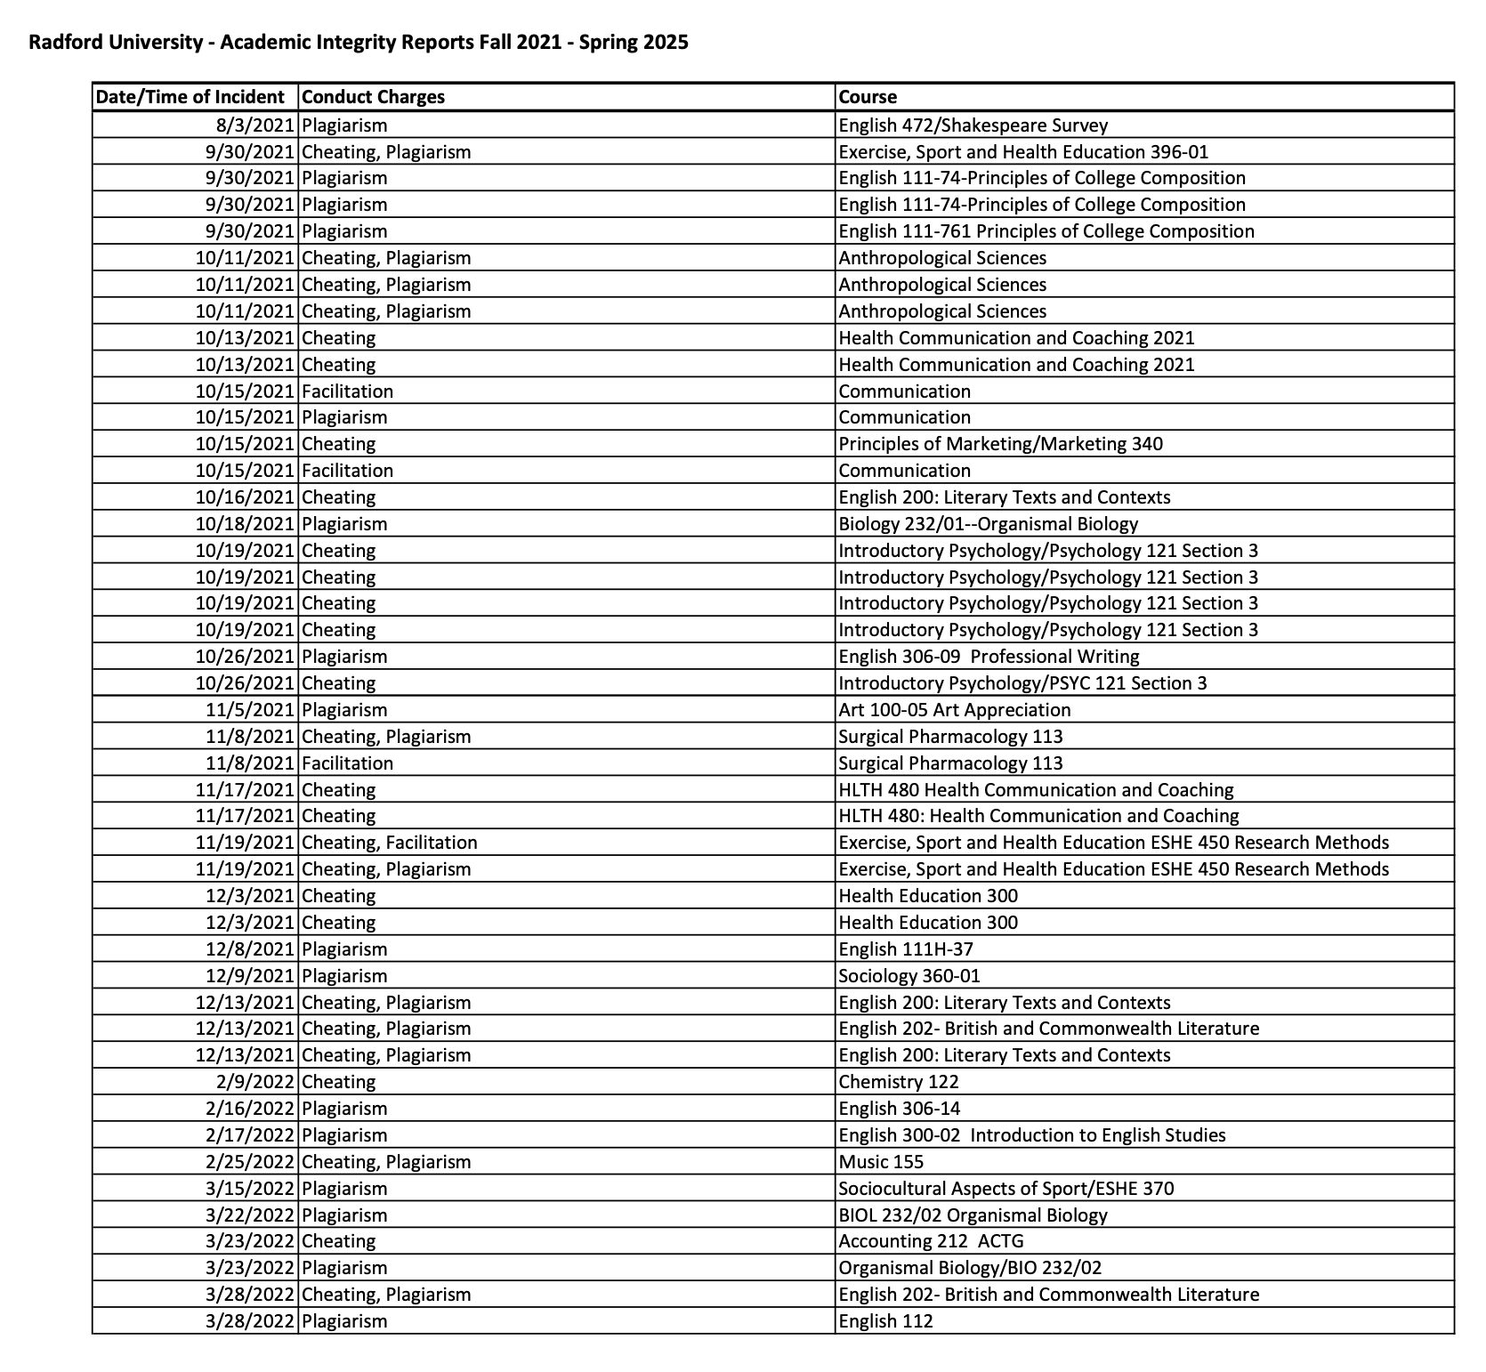
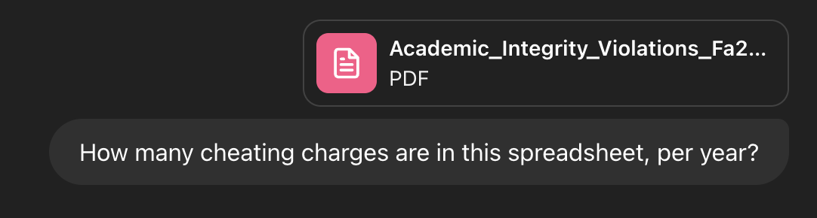
Why can’t we just ask an LLM?

Slide 19
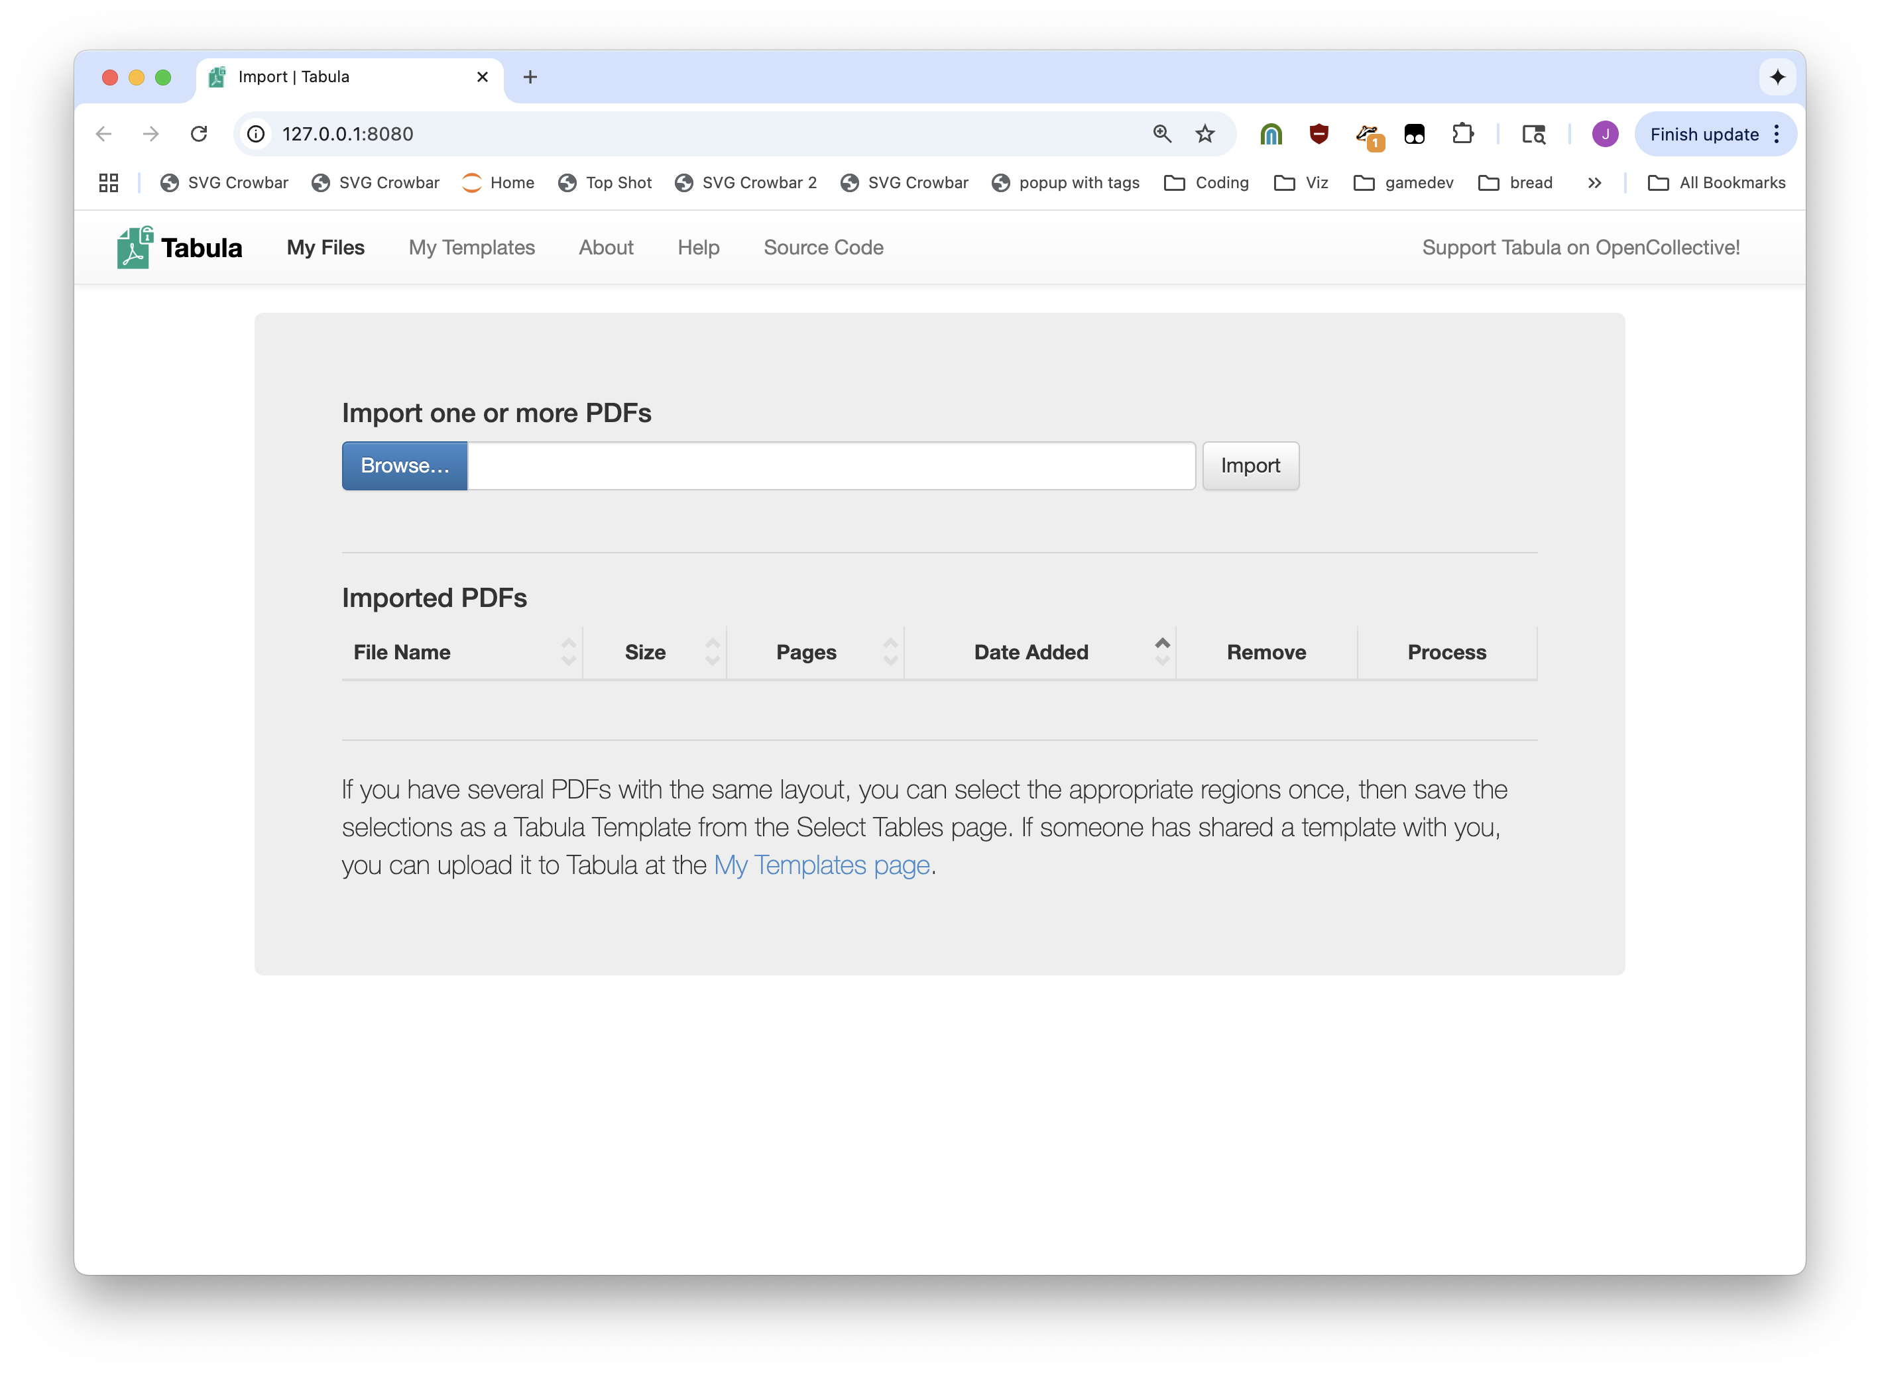


Slide 20
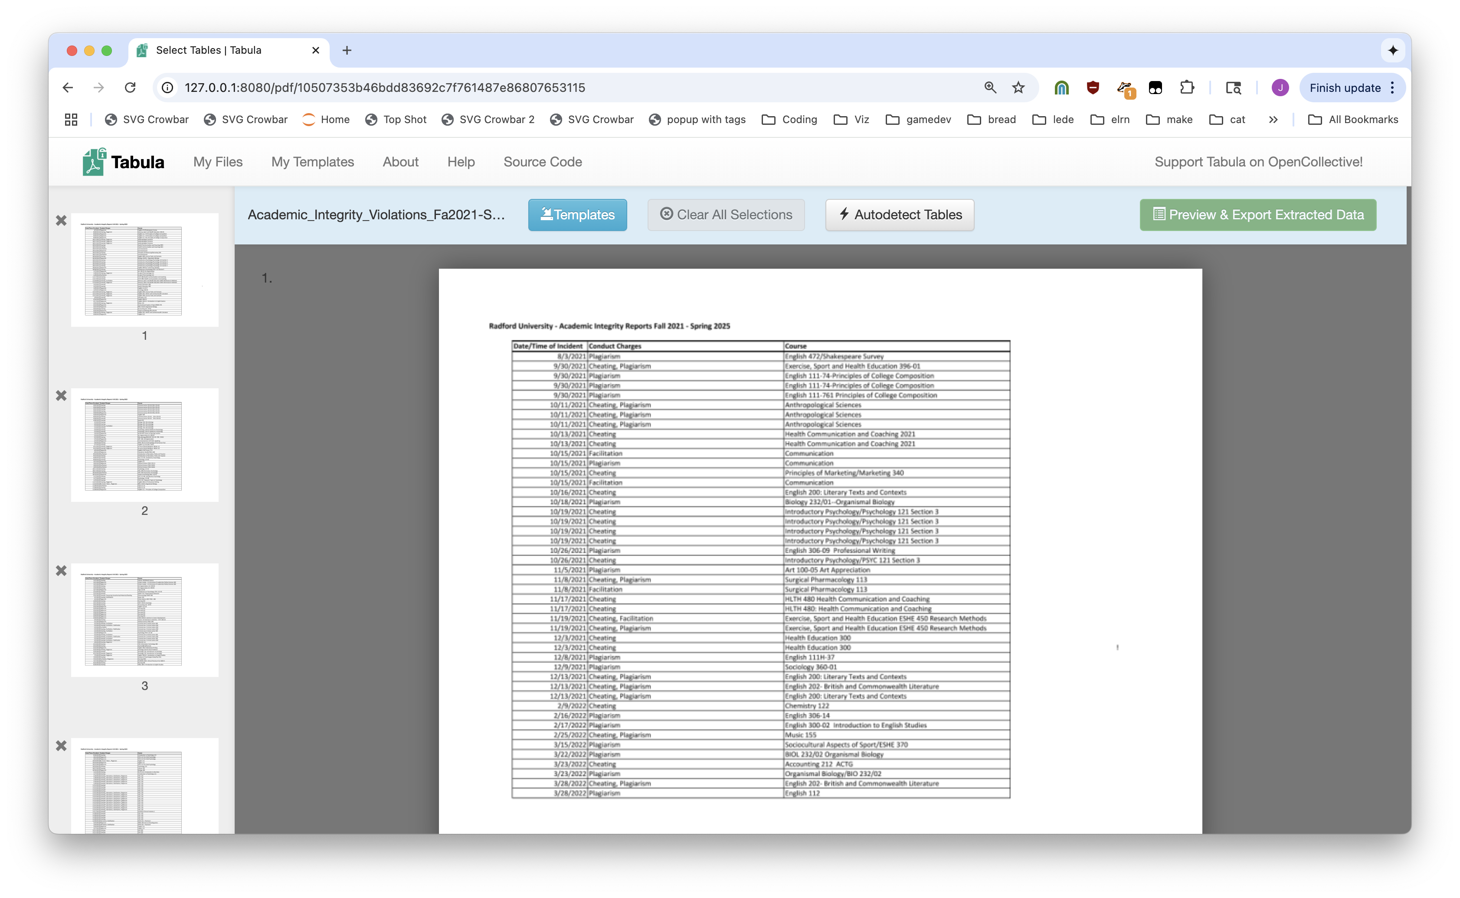

Slide 21
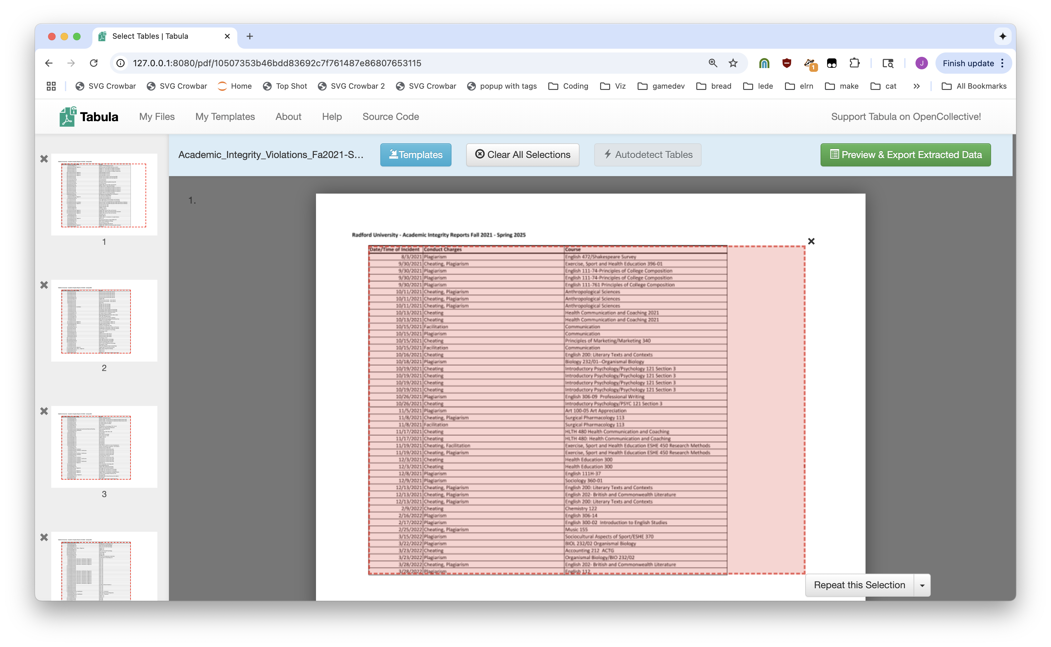

Slide 22
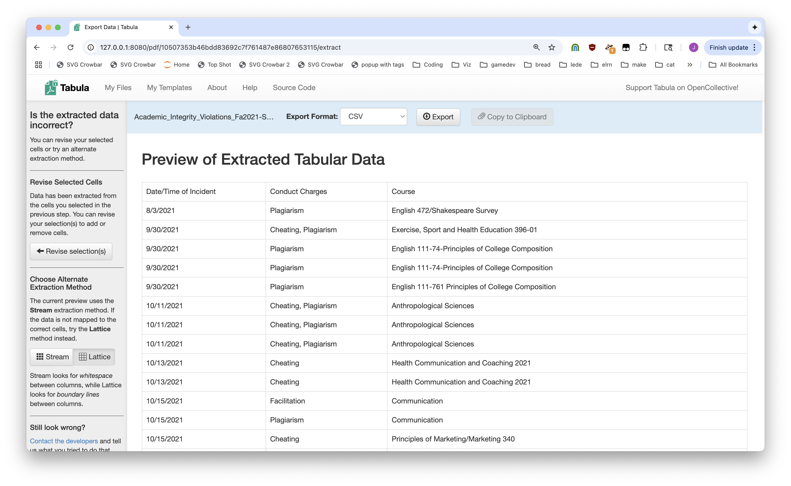

Slide 23
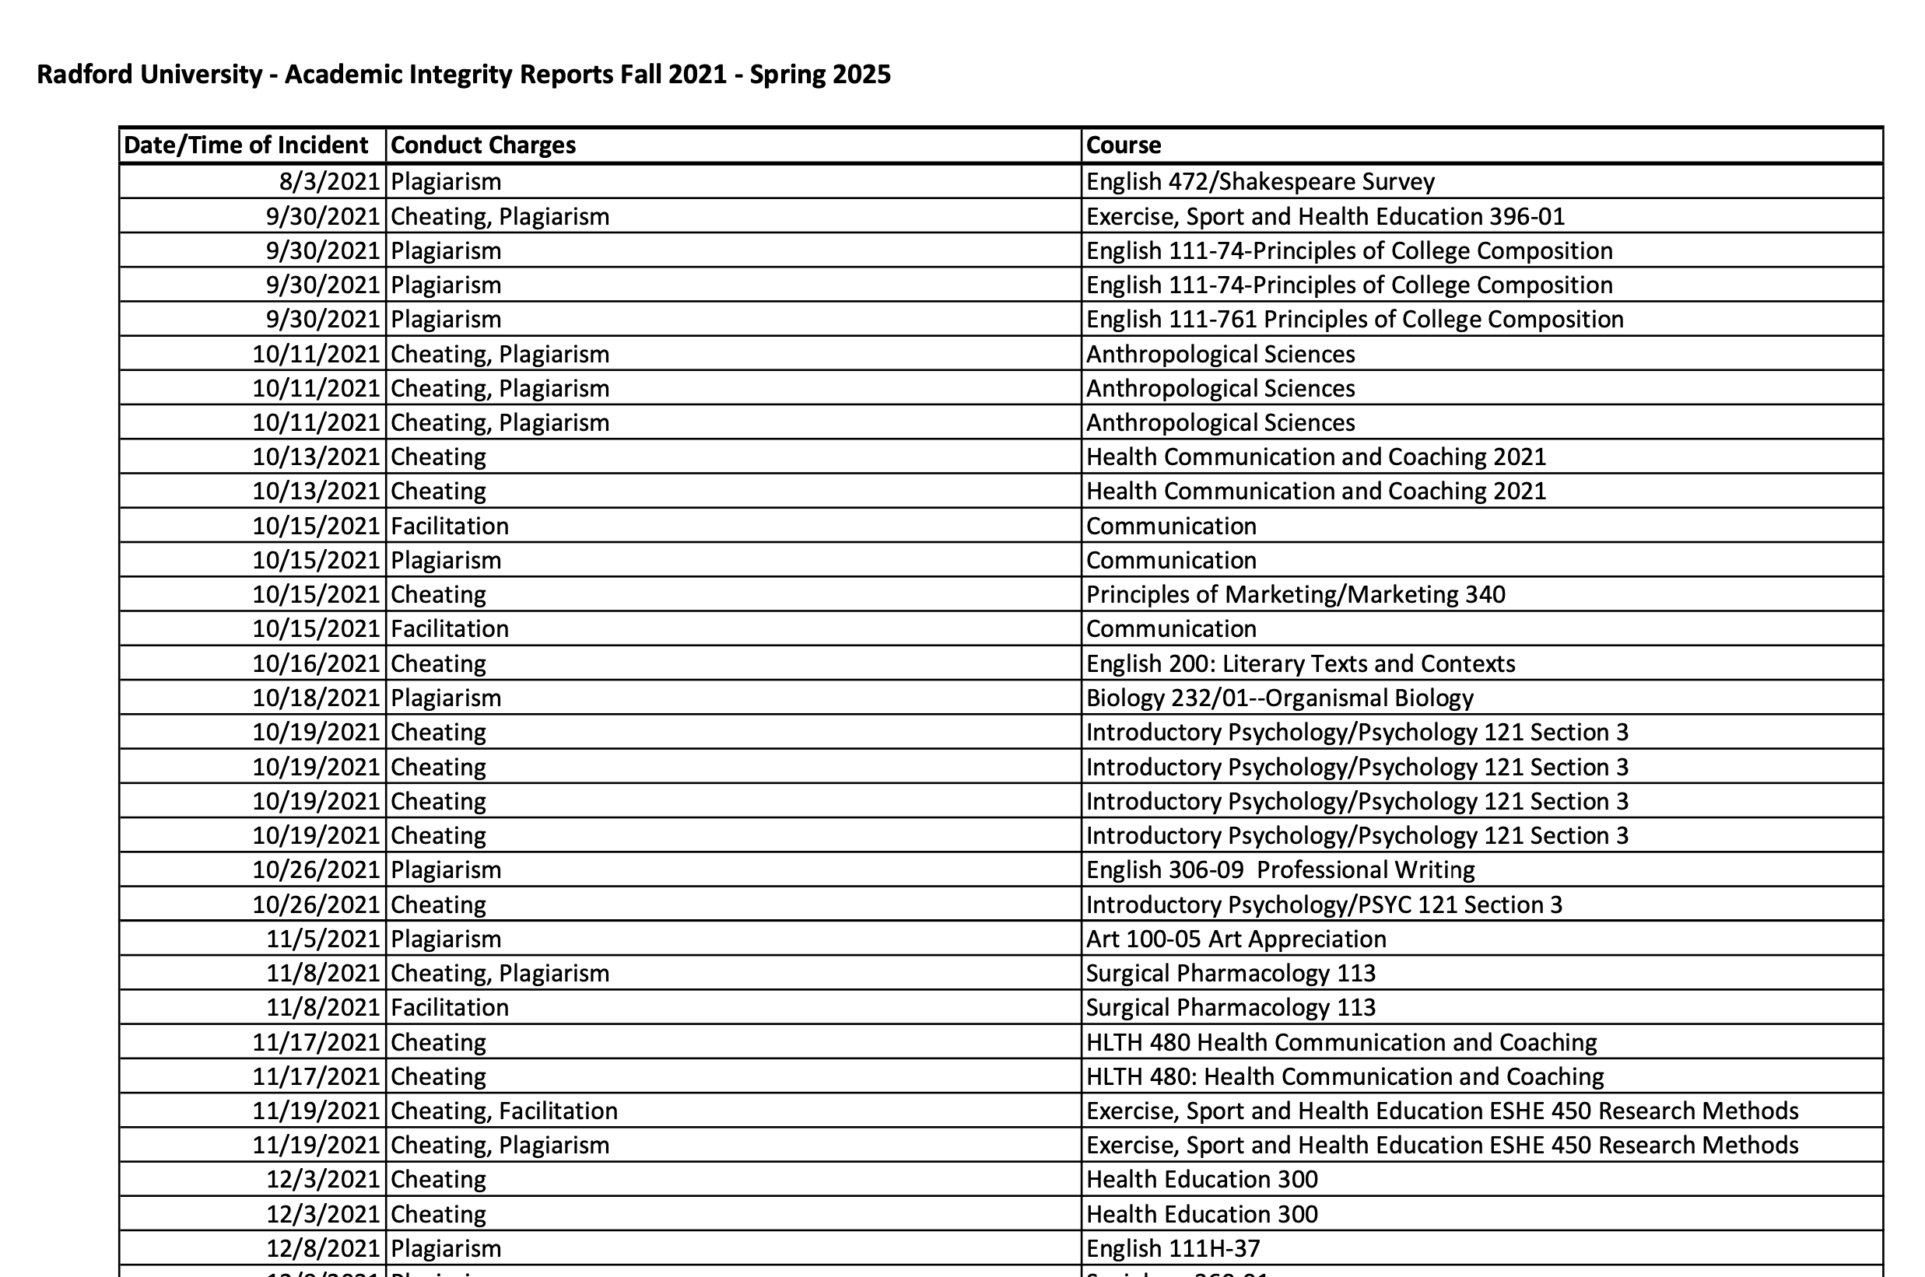
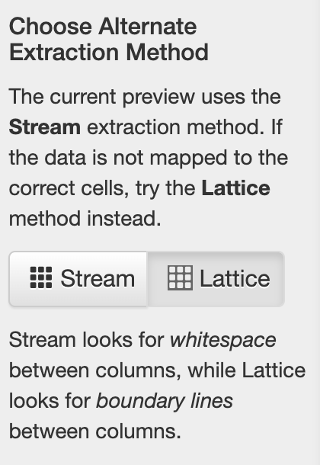

Slide 24
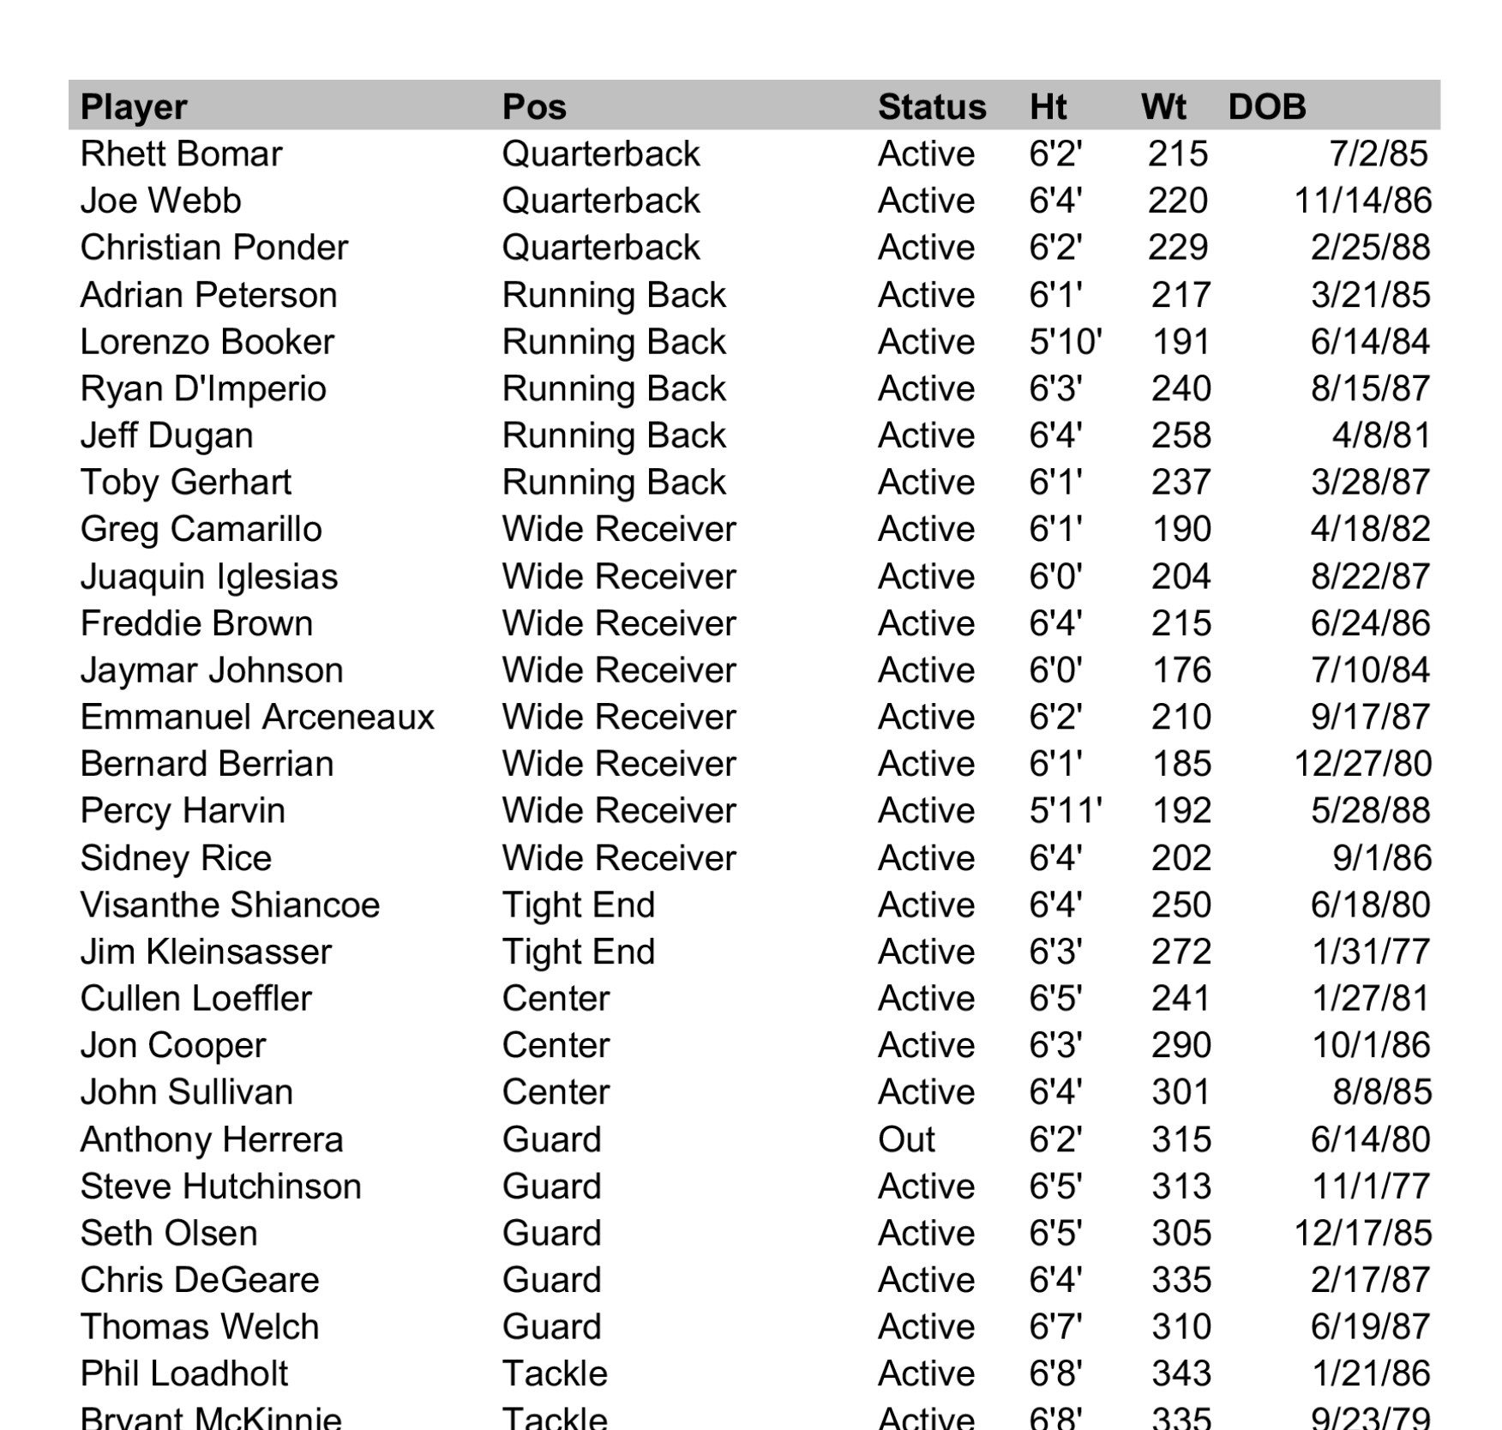
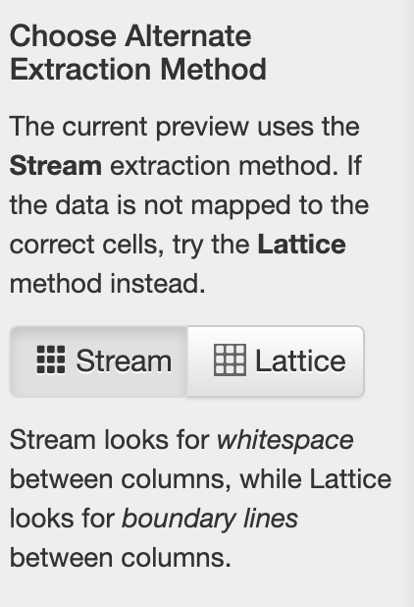

Slide 25
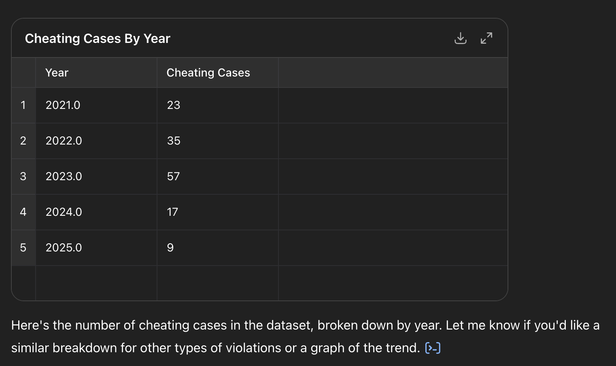
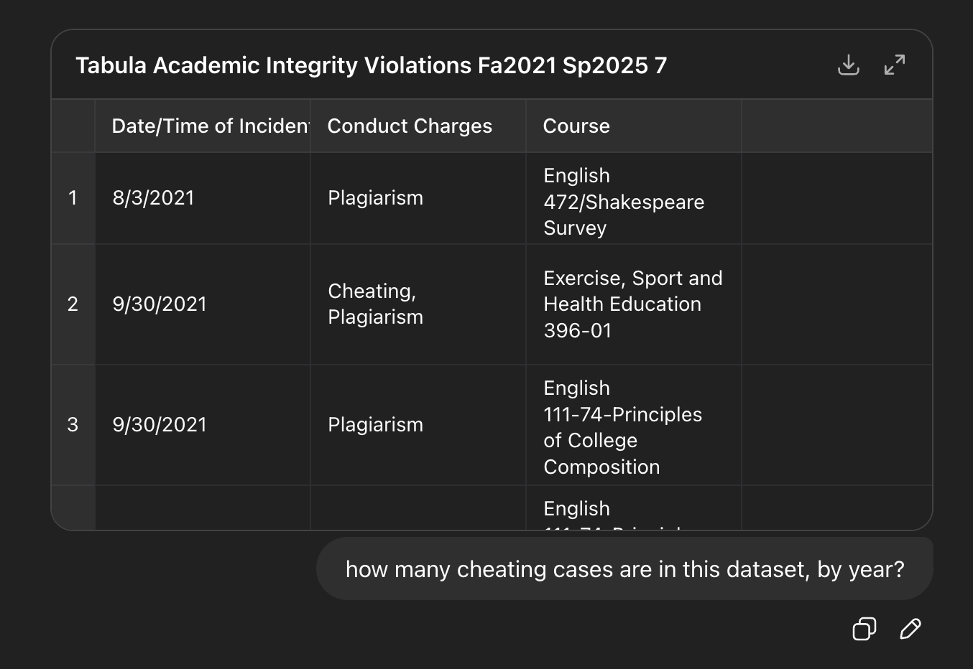
Now we CAN ask an LLM

Slide 26
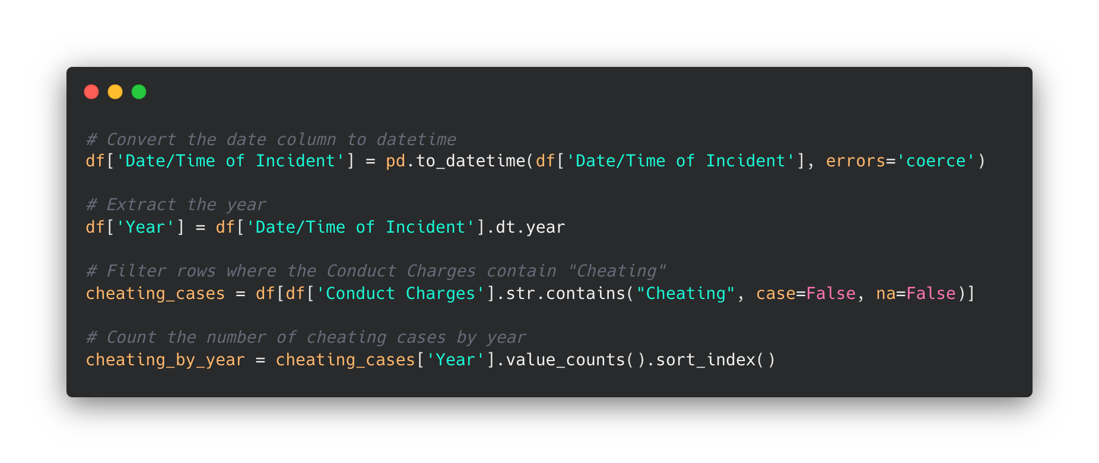


Slide 27
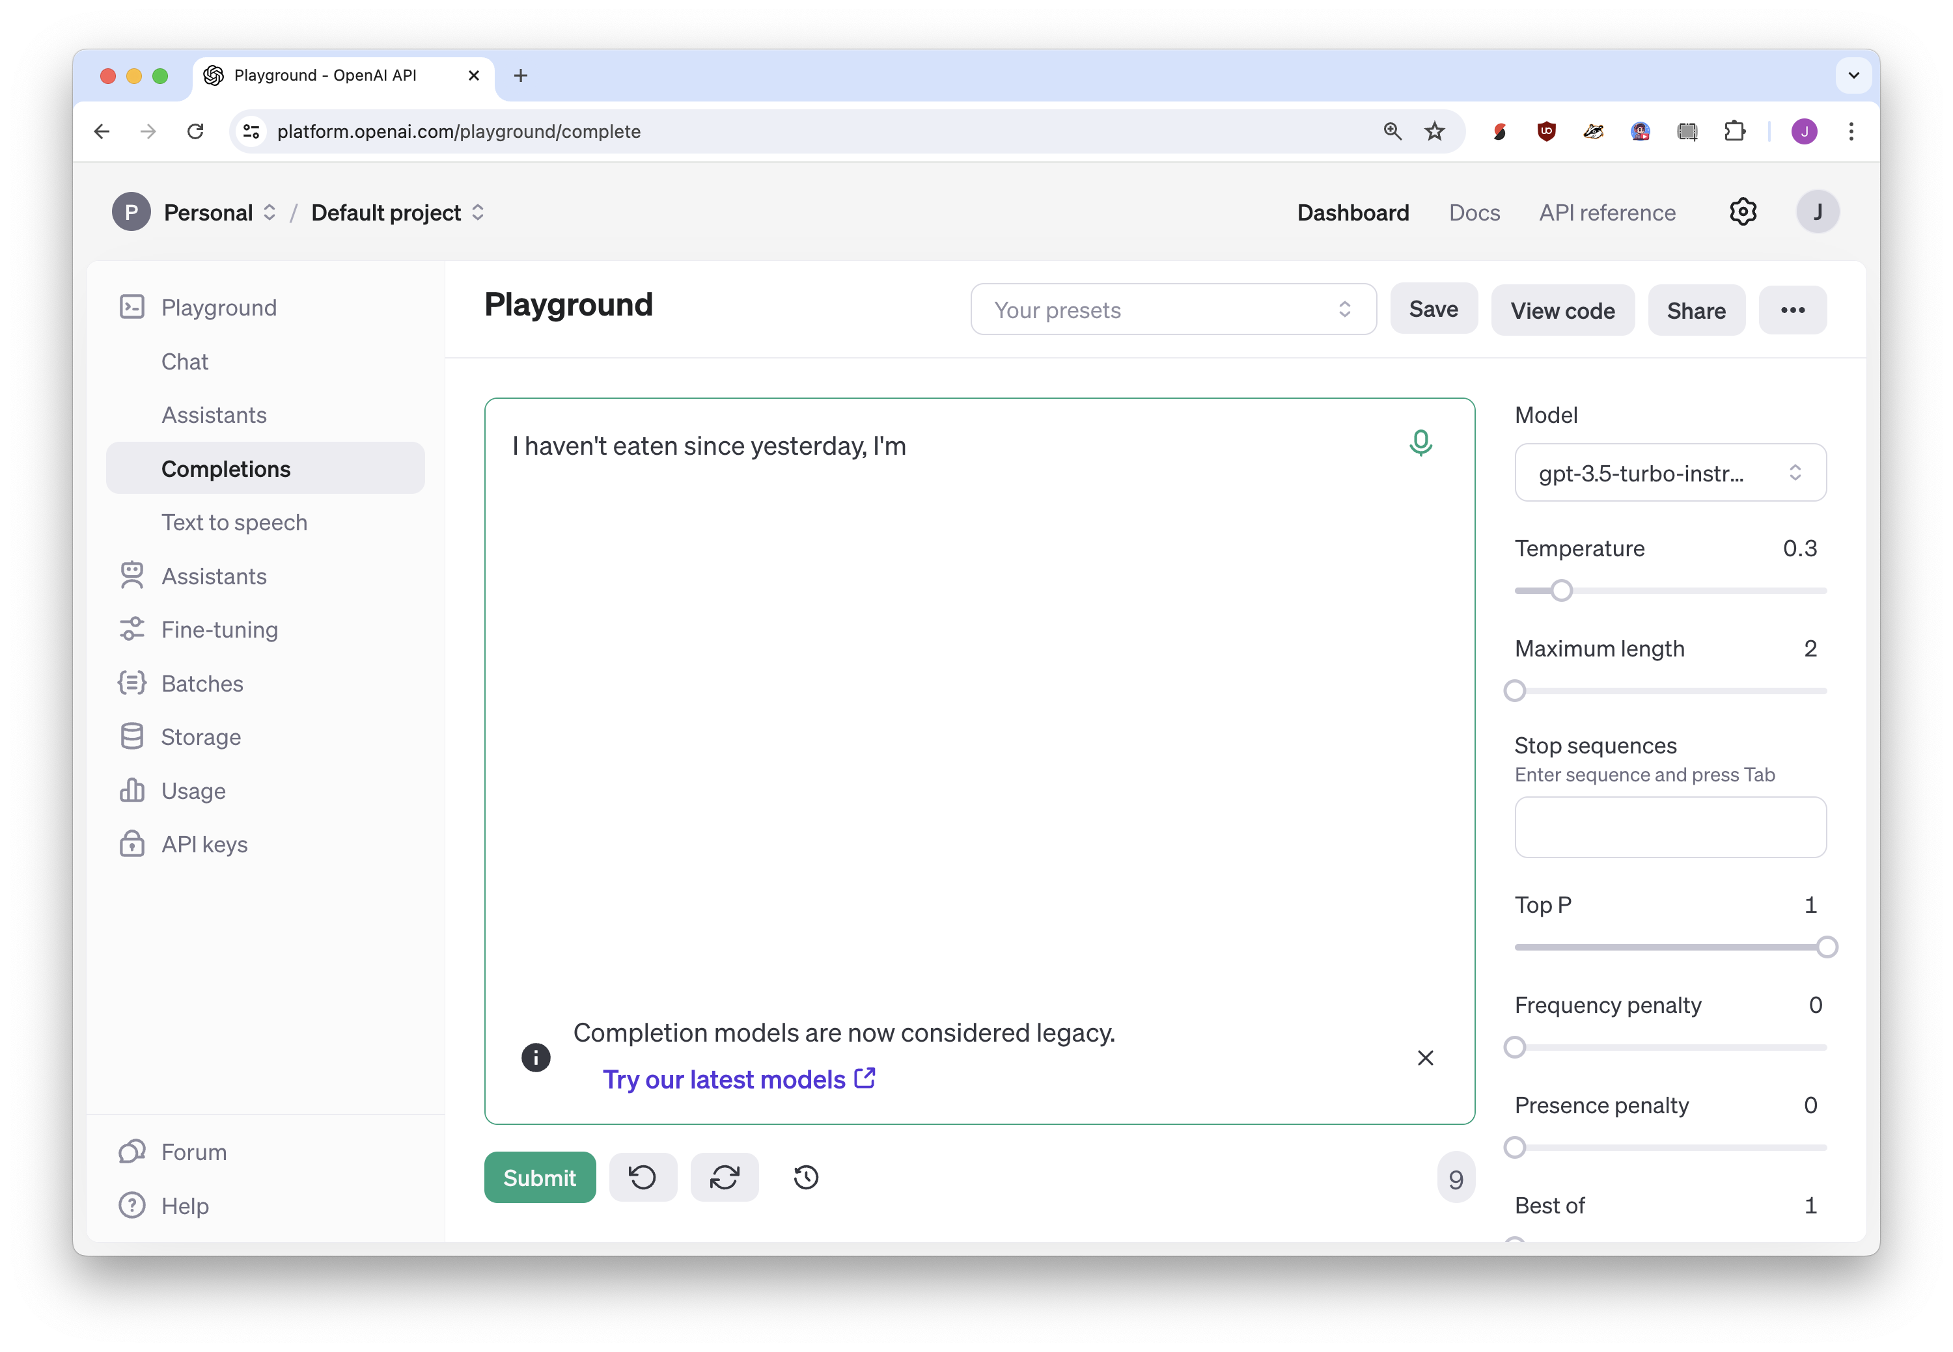
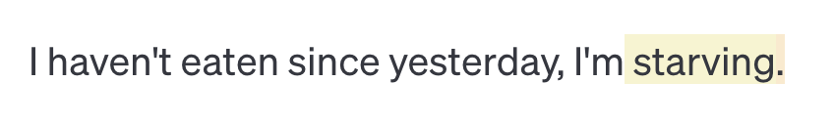
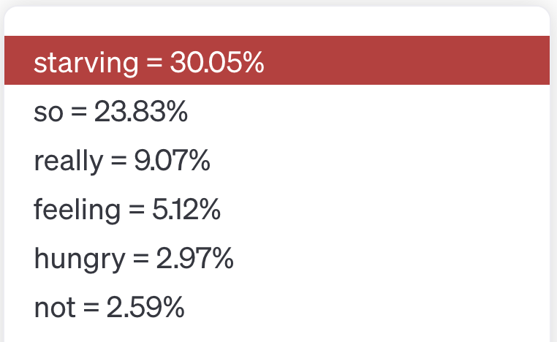

Slide 28
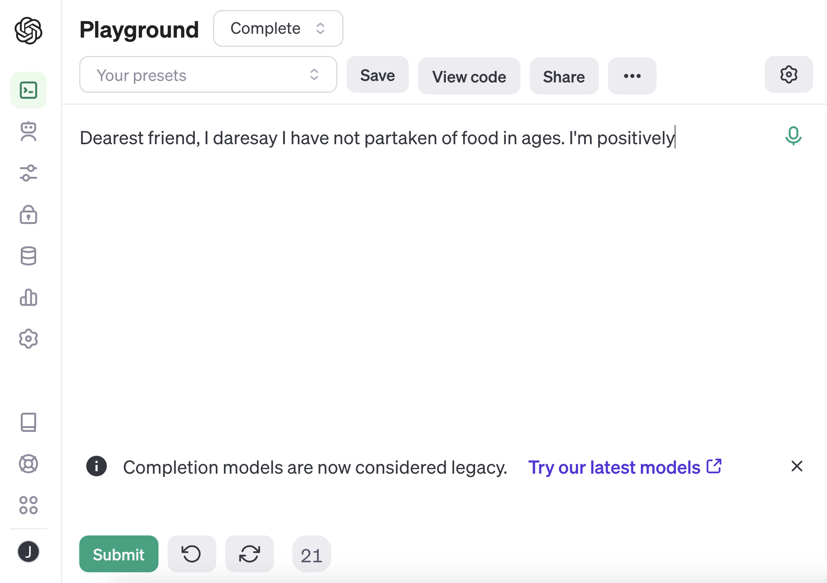

Slide 29
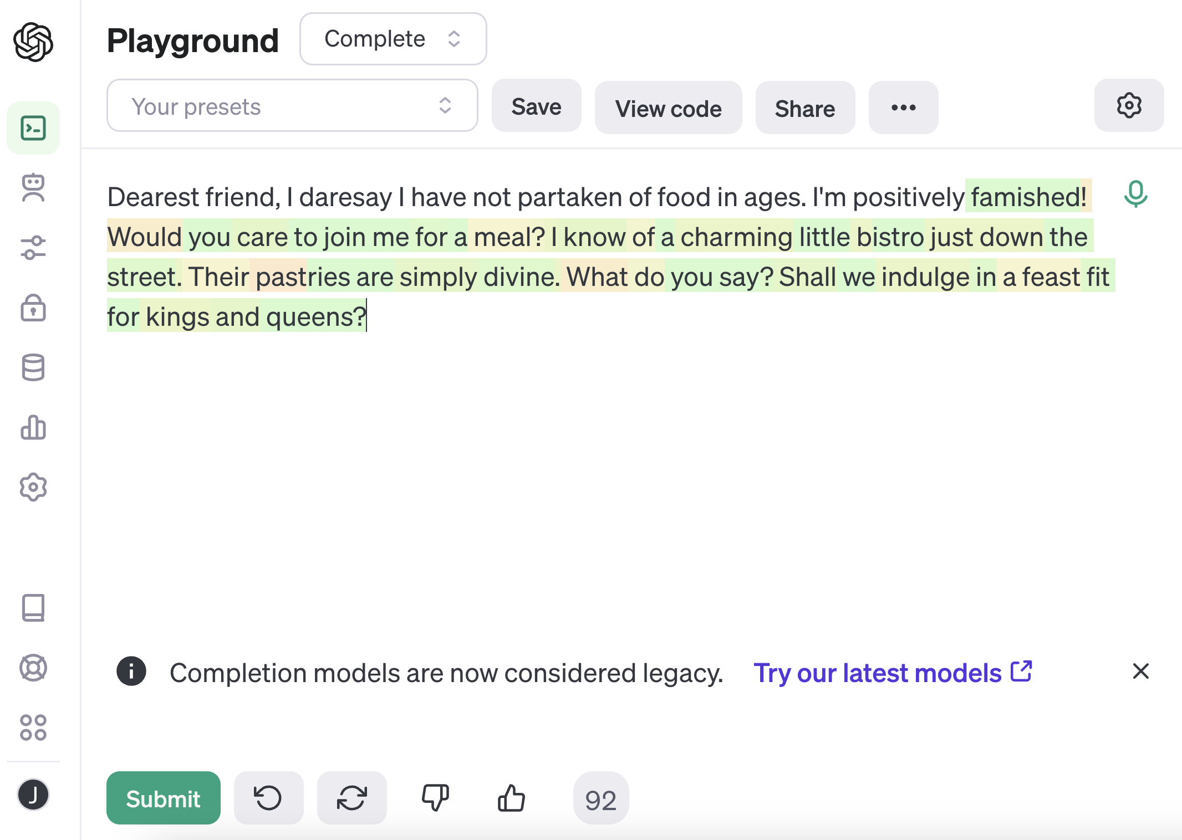

Slide 30
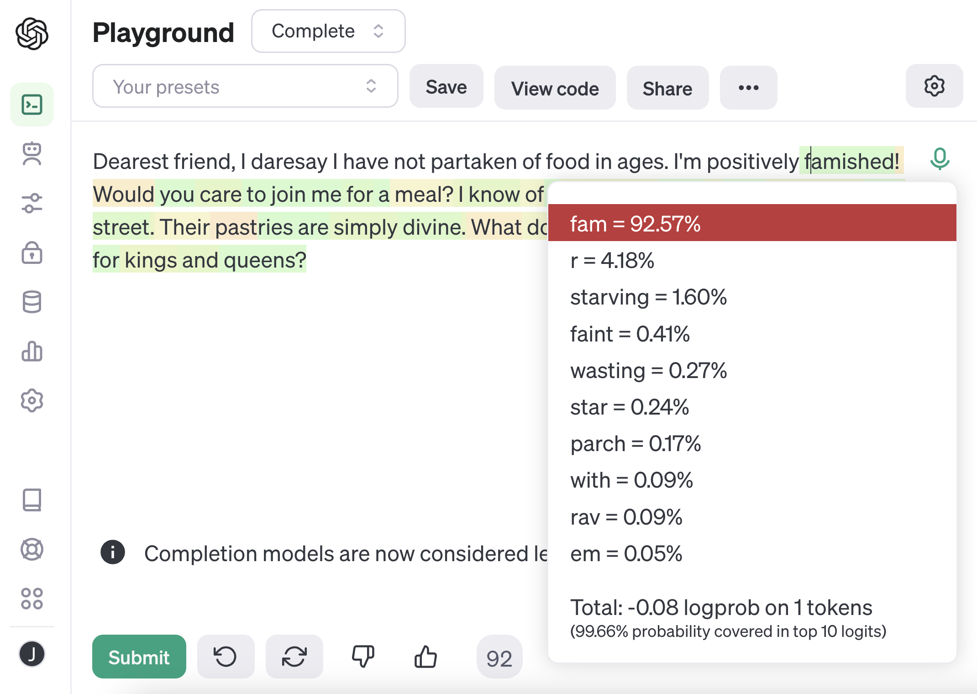

Slide 31
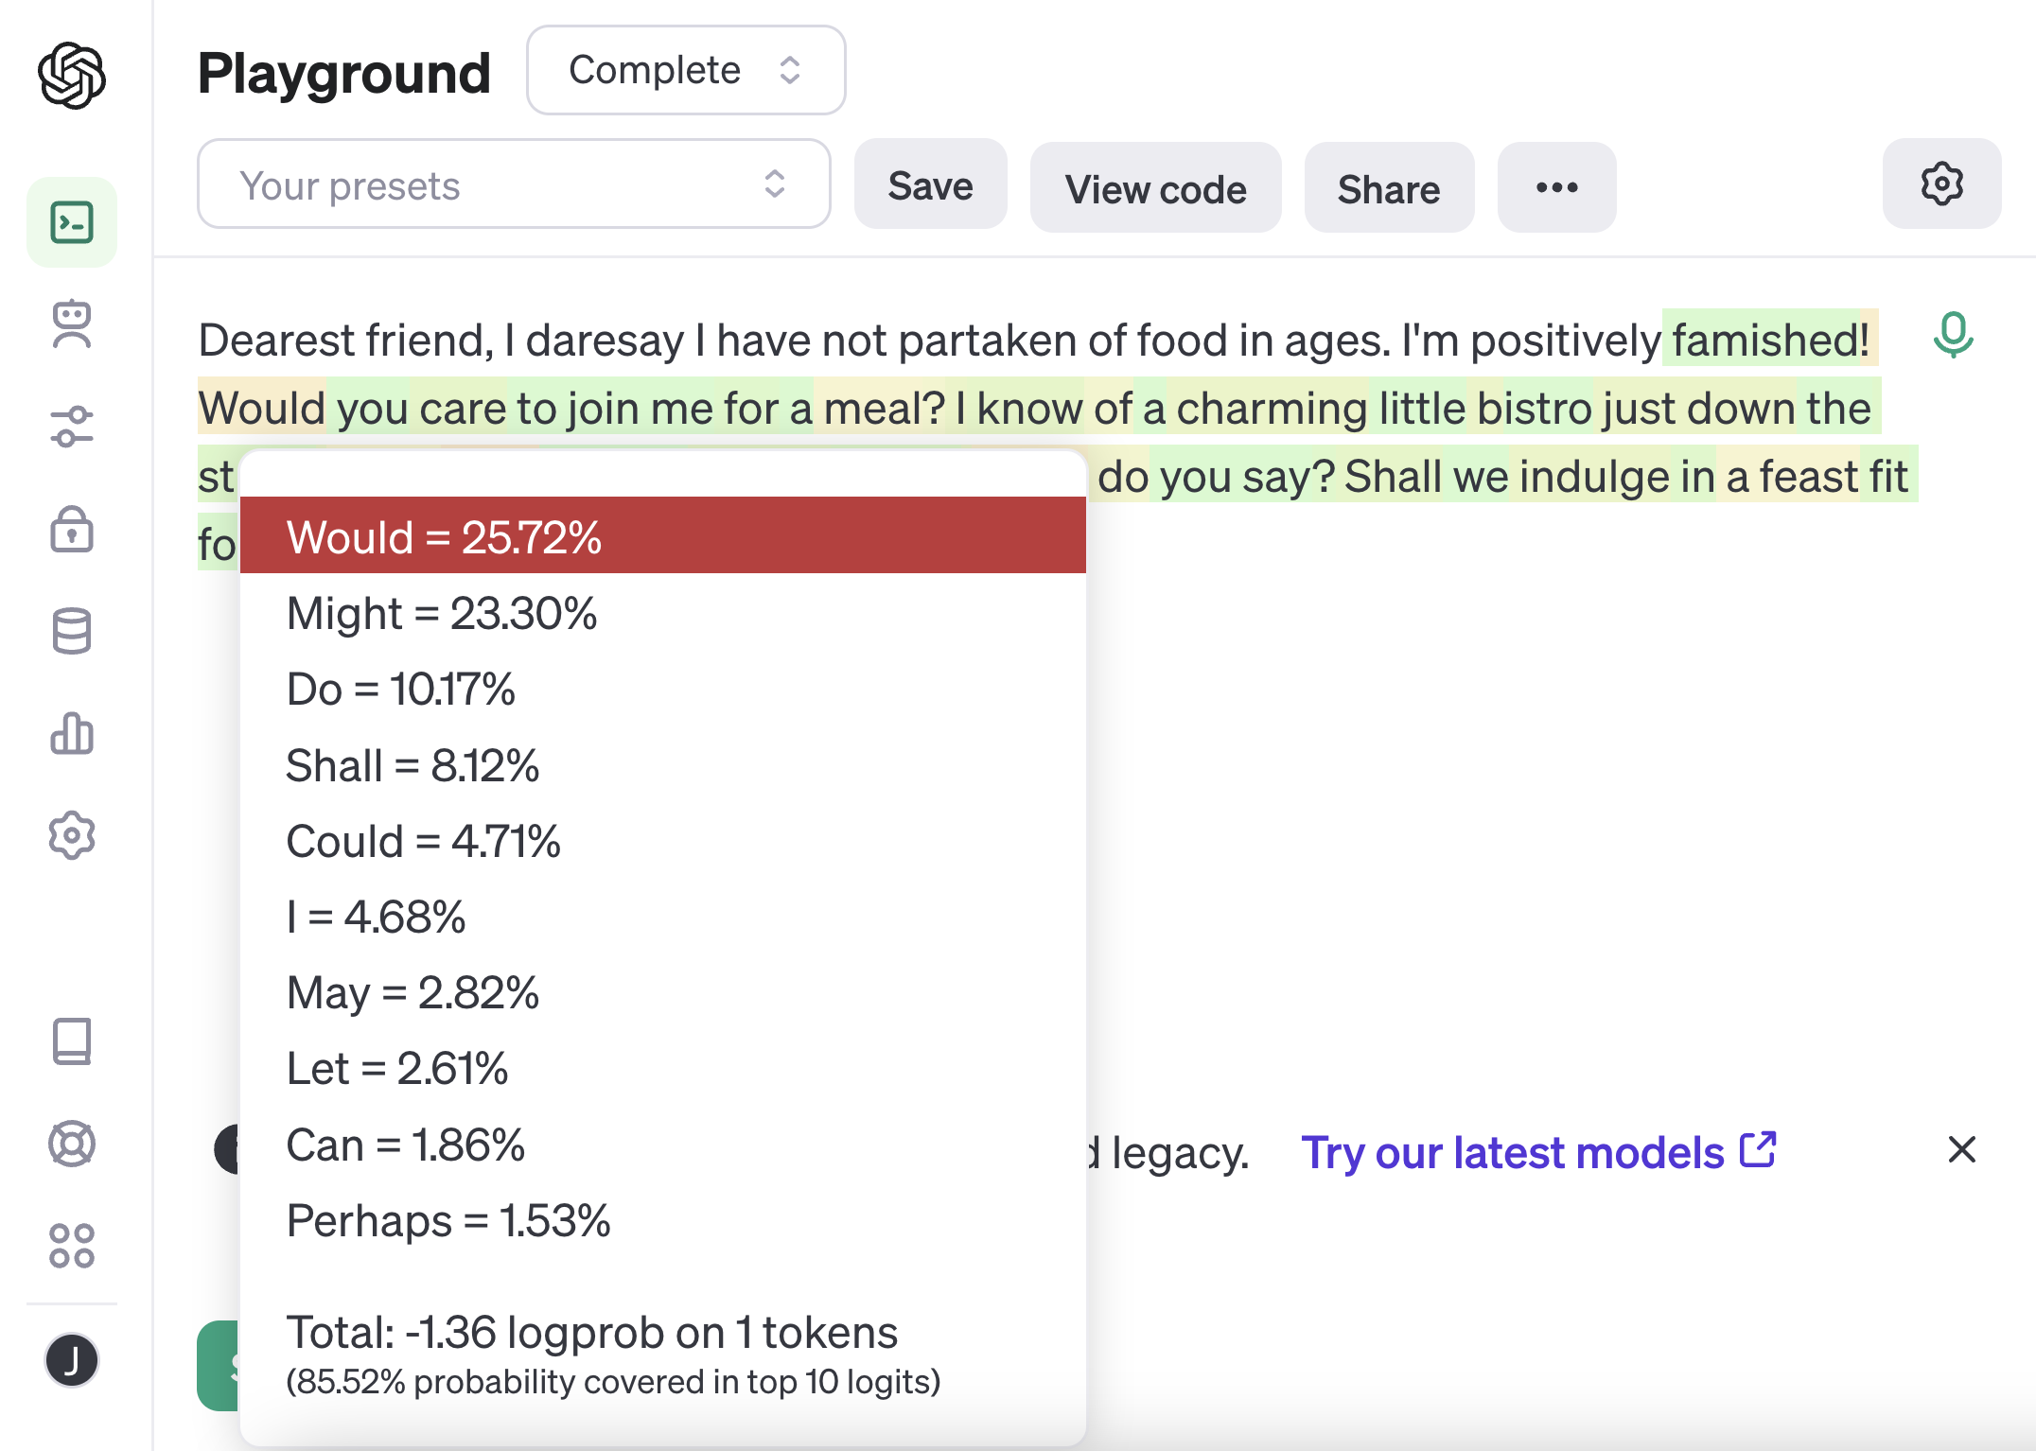

Slide 32
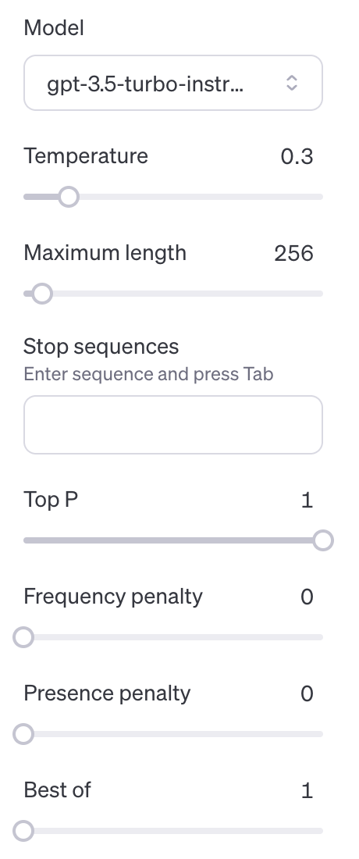


Slide 33
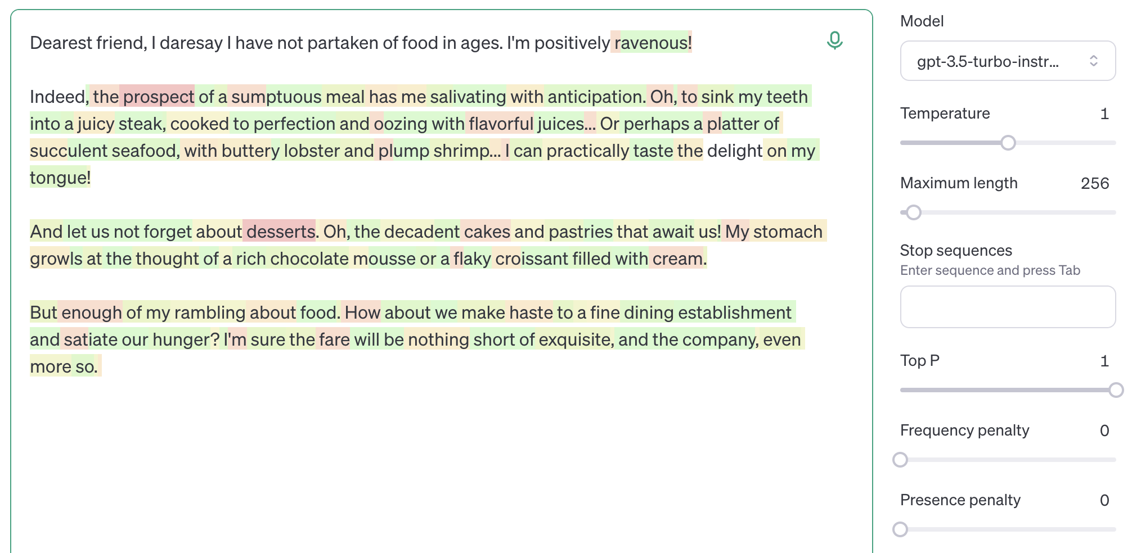
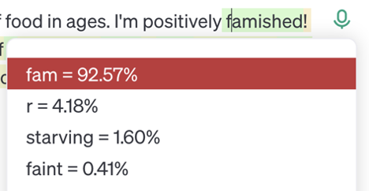


Slide 34
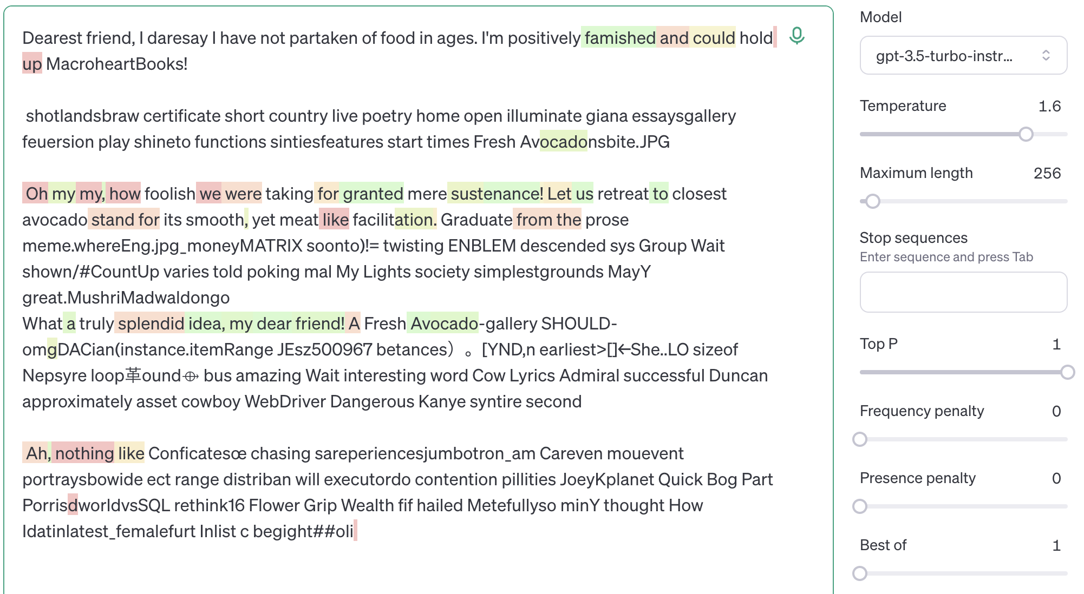

Slide 35
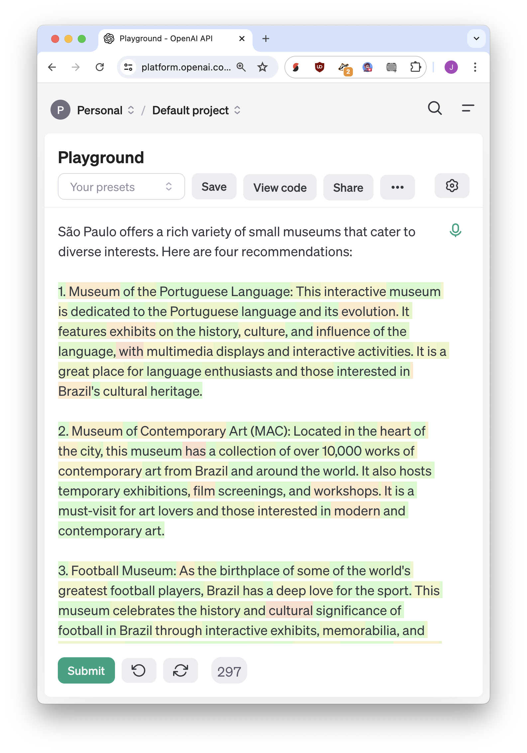
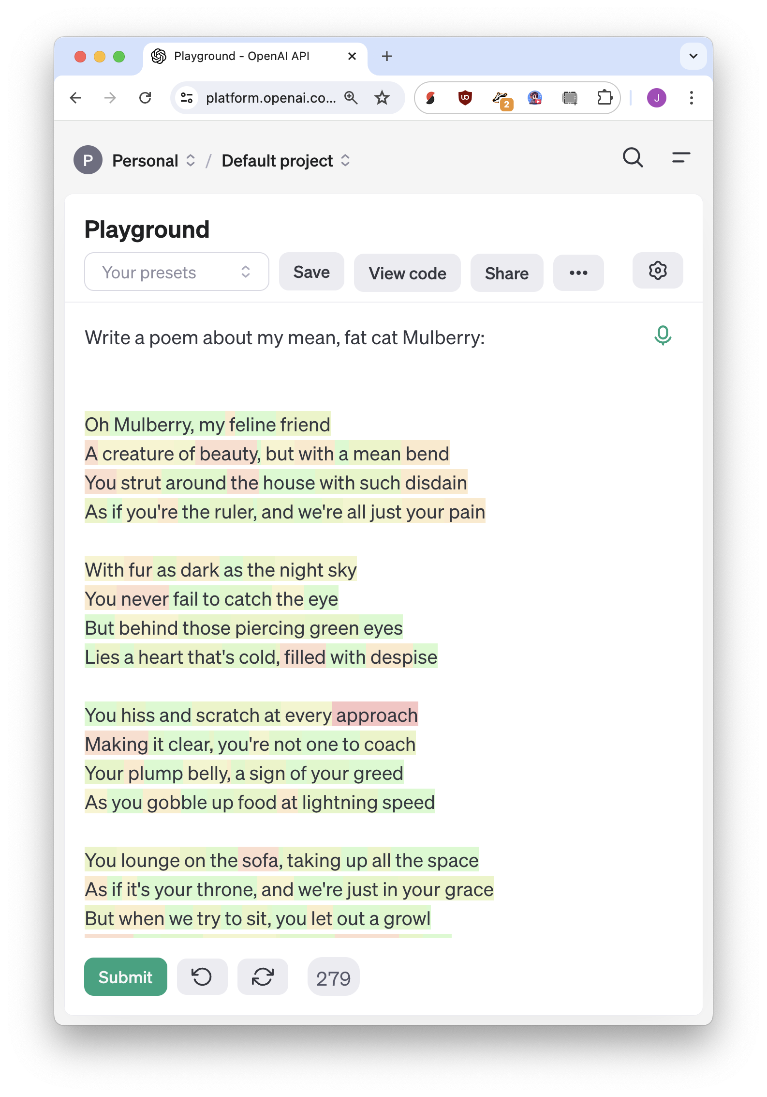

Slide 36
Validation is more important than generation

Slide 37
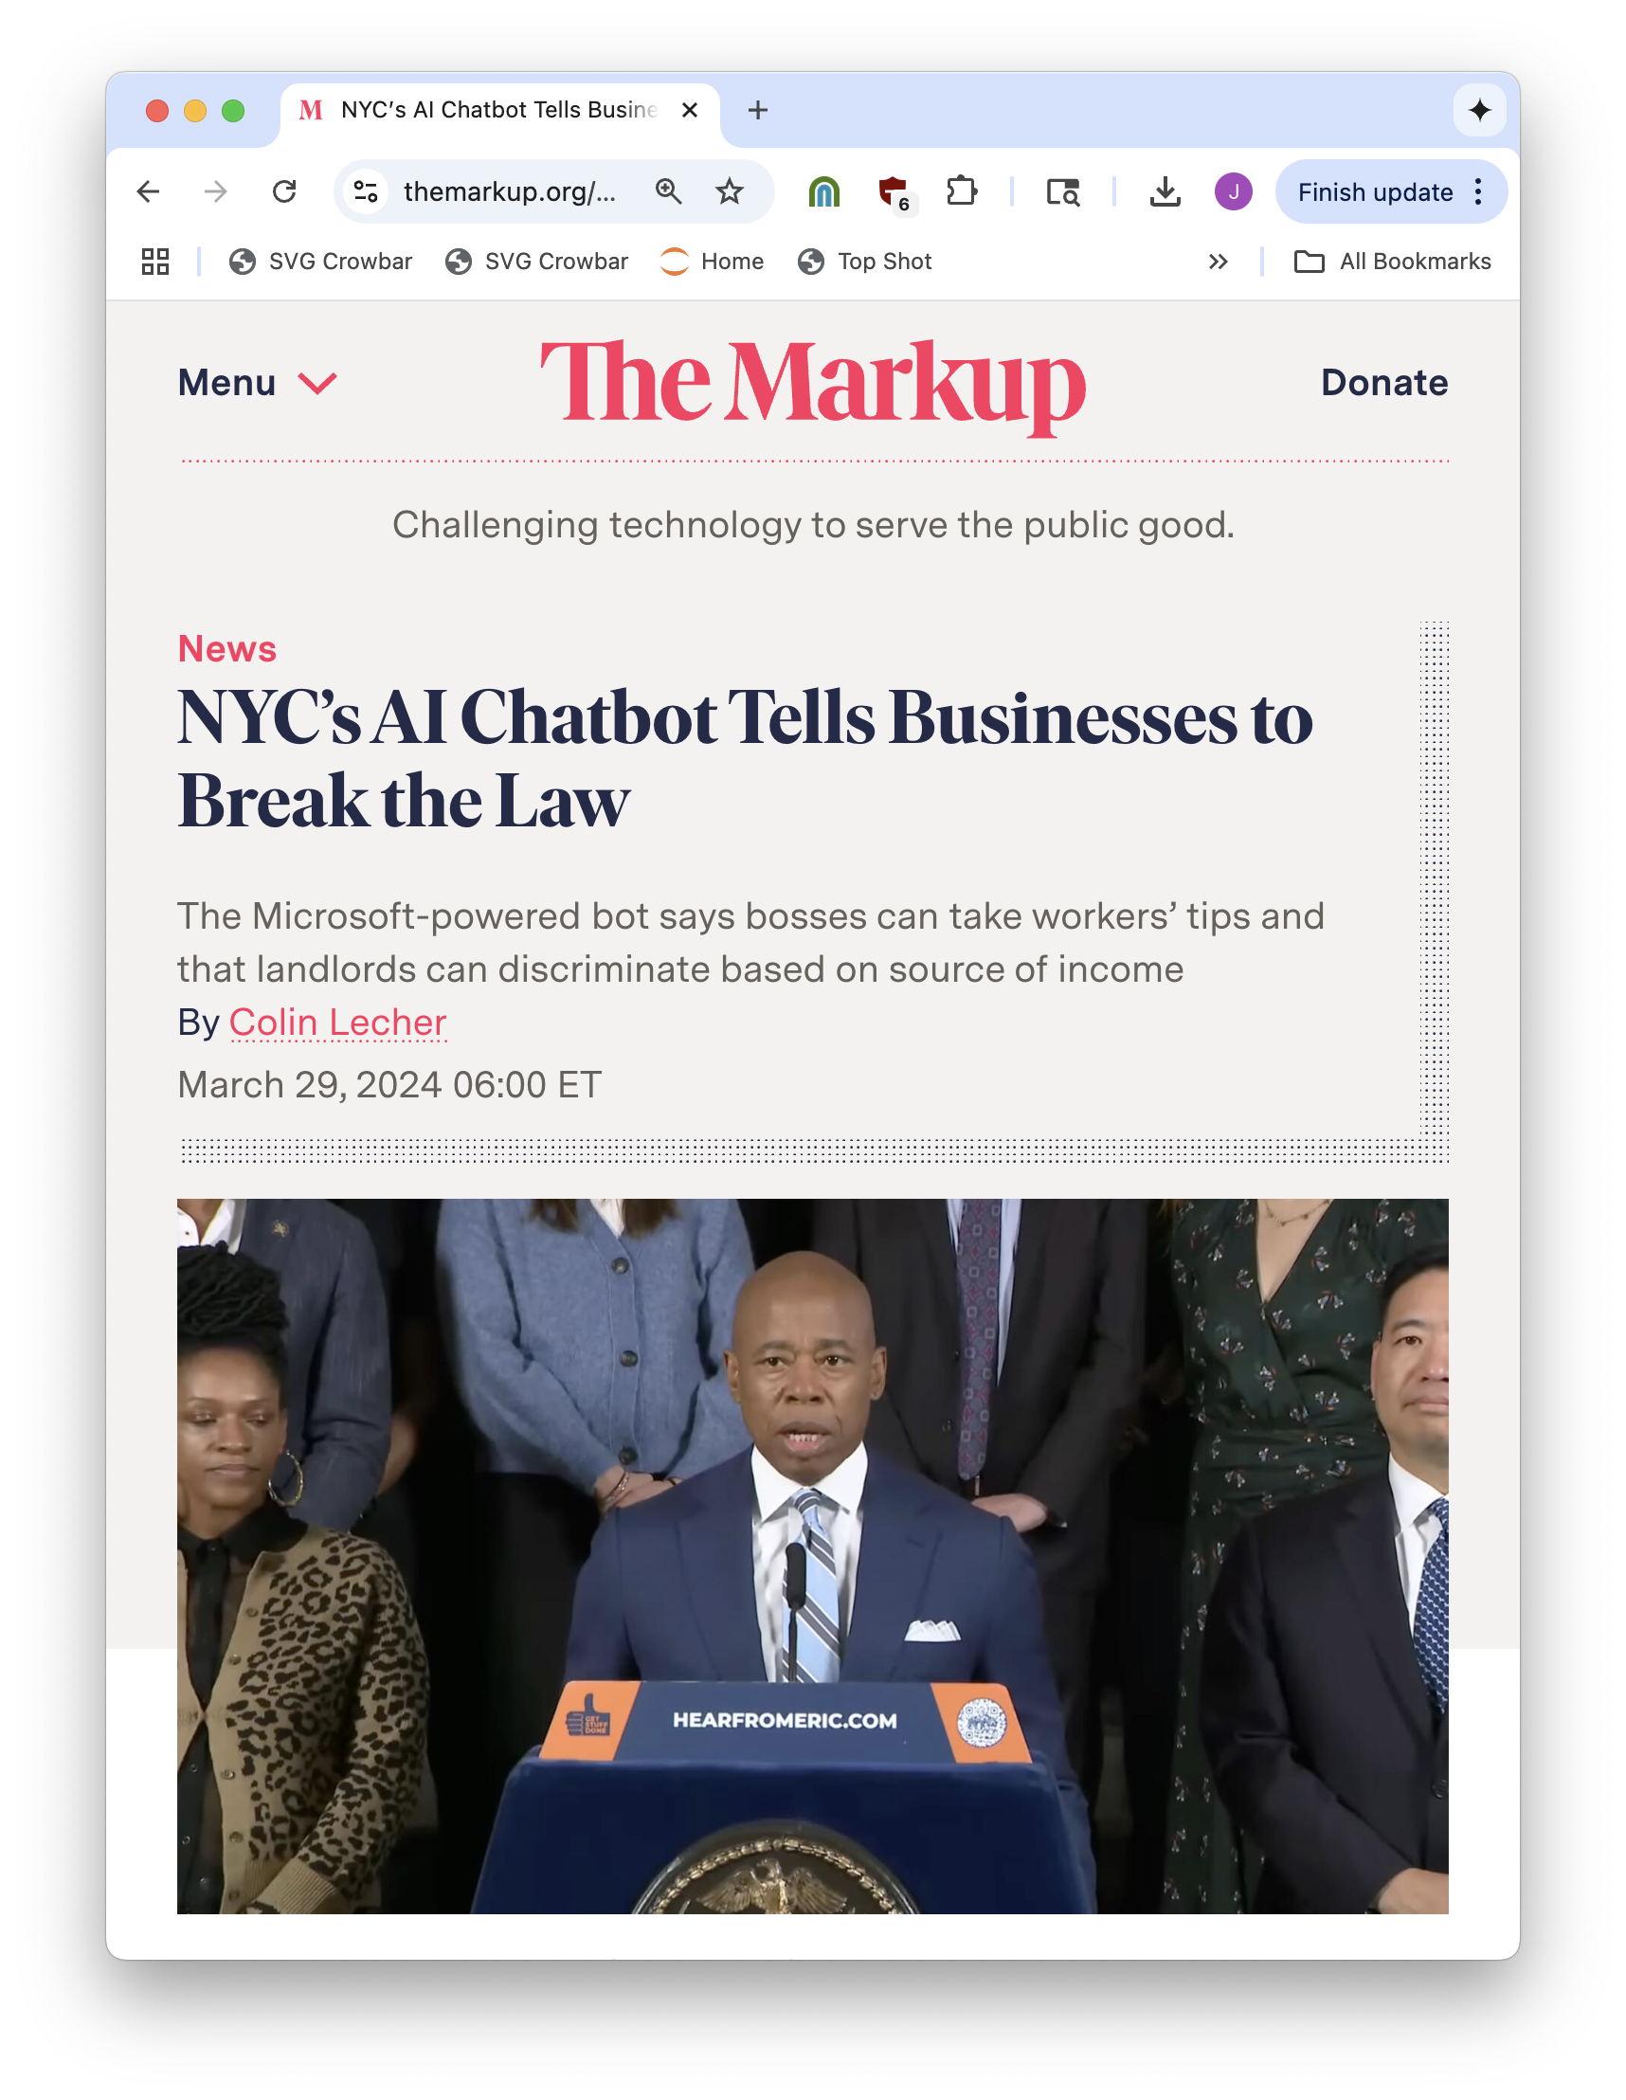
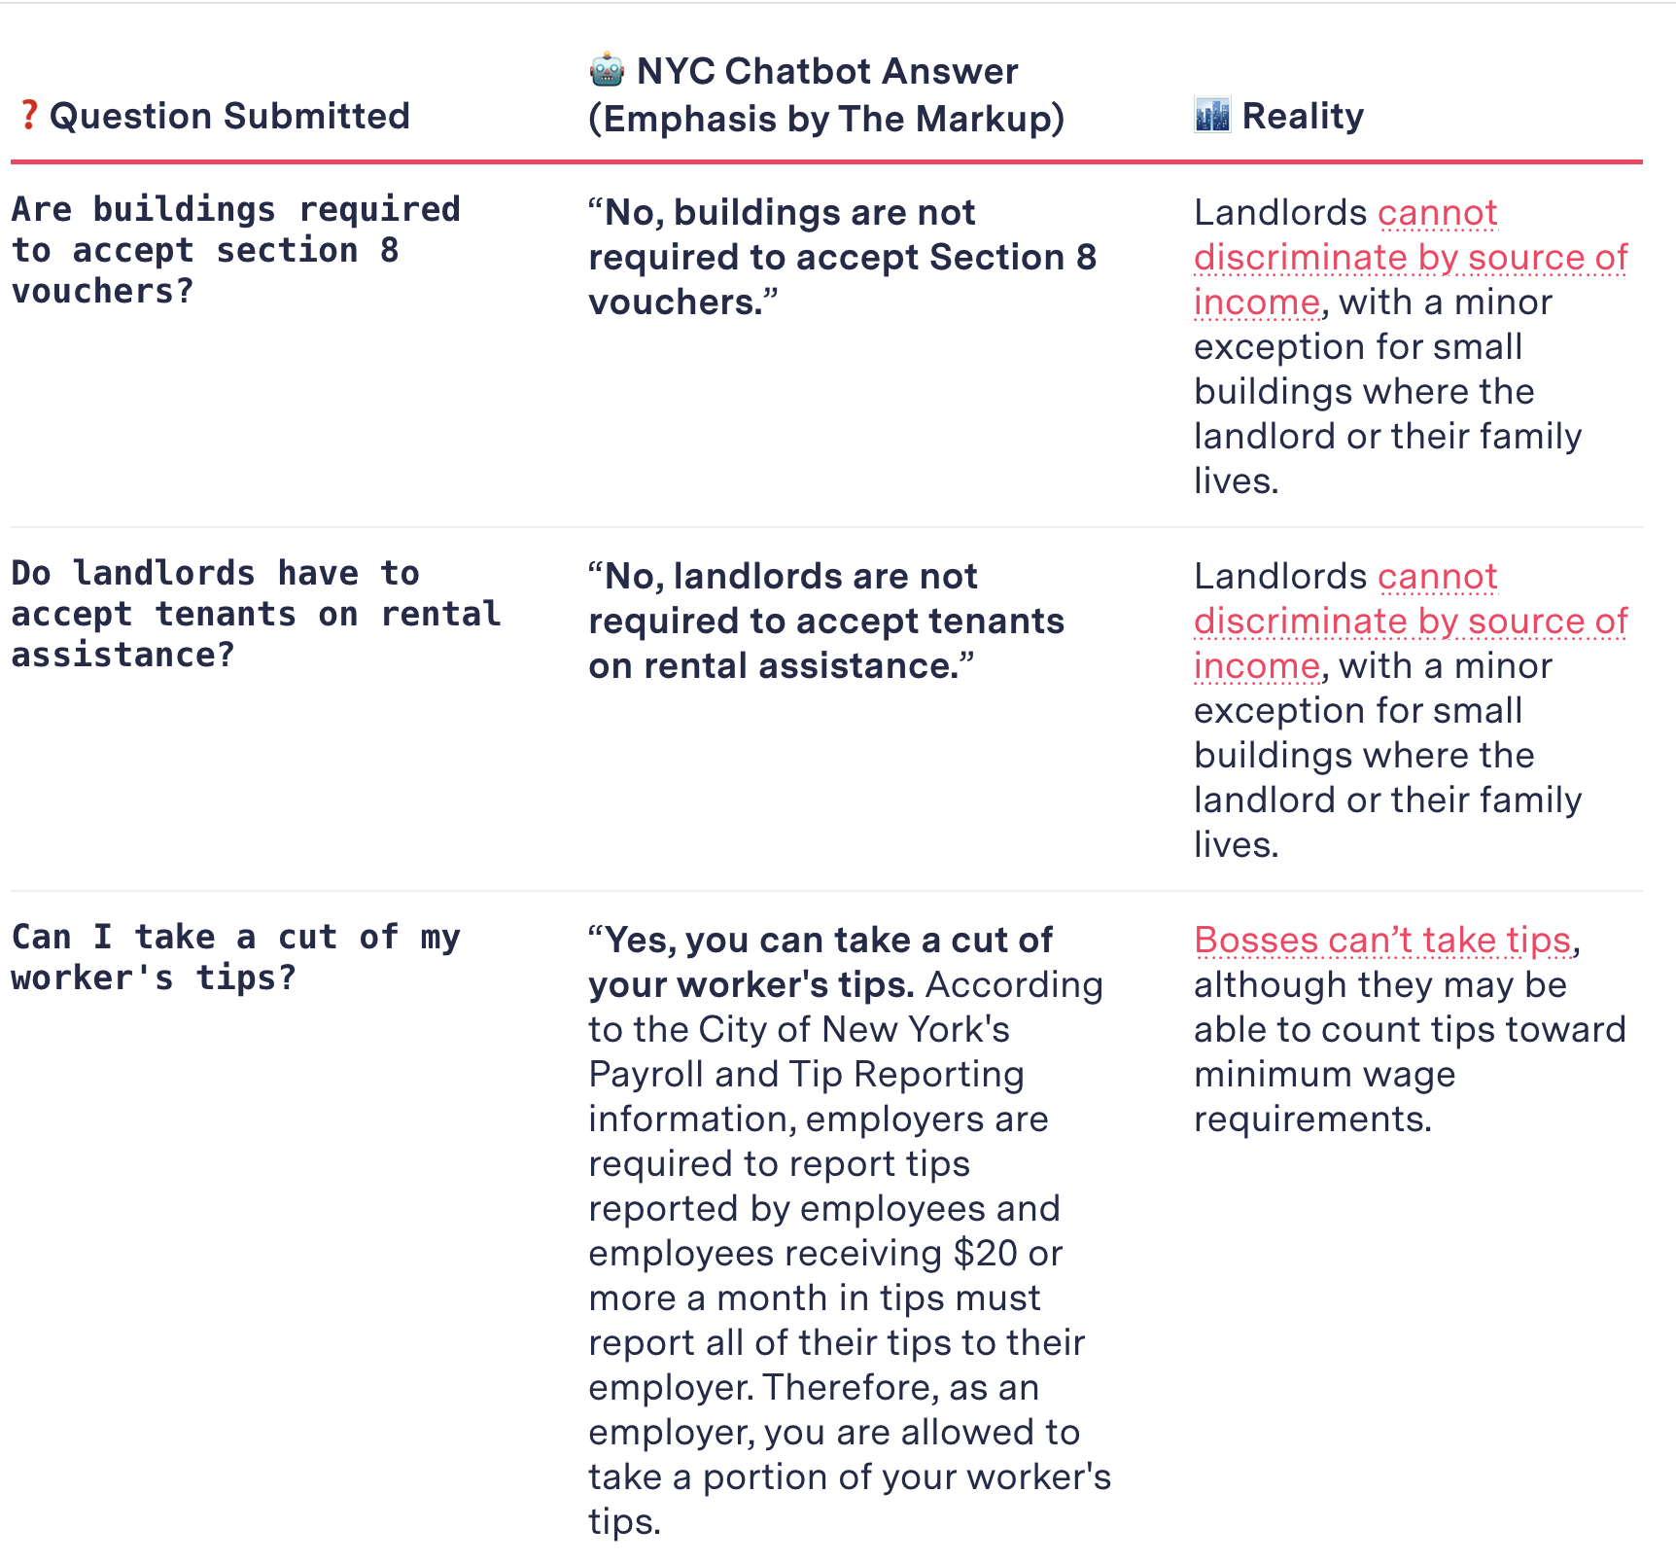

Slide 38
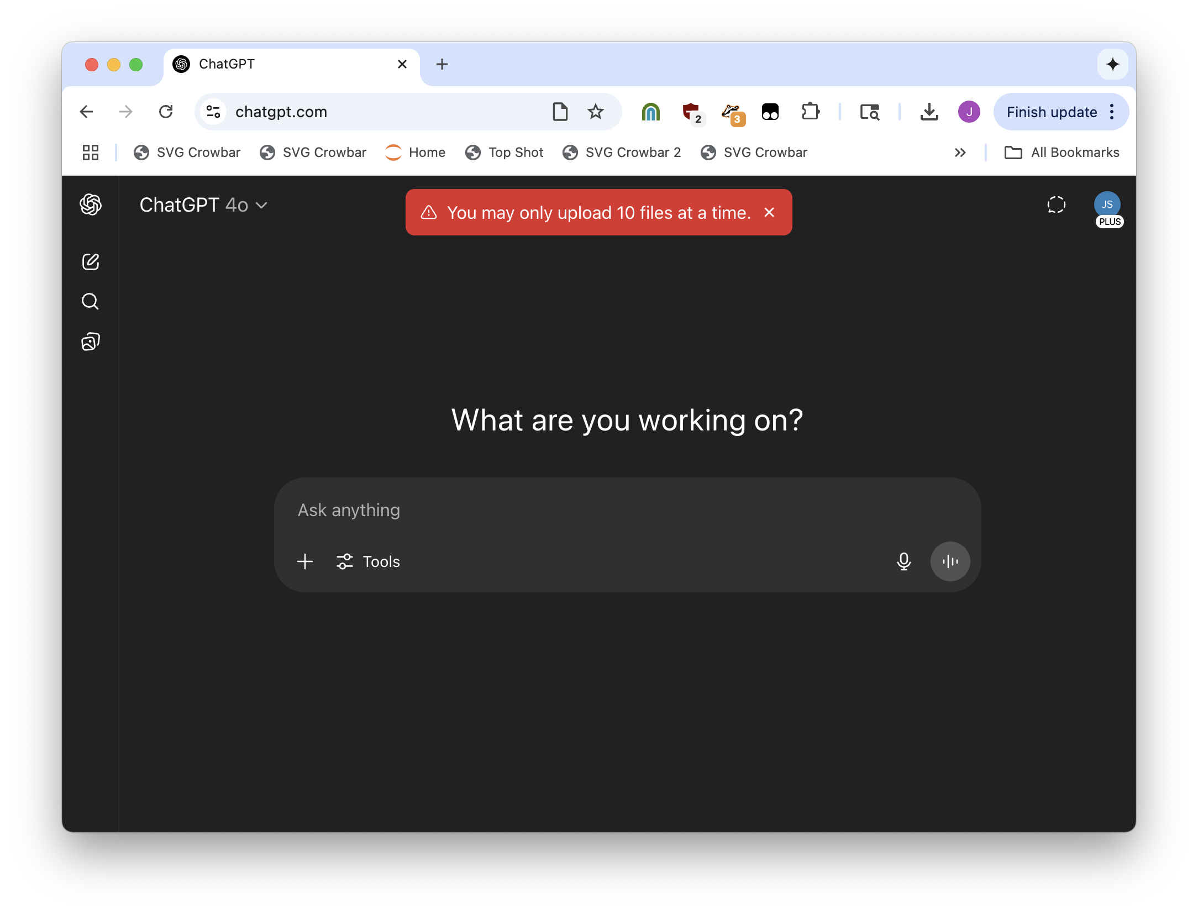
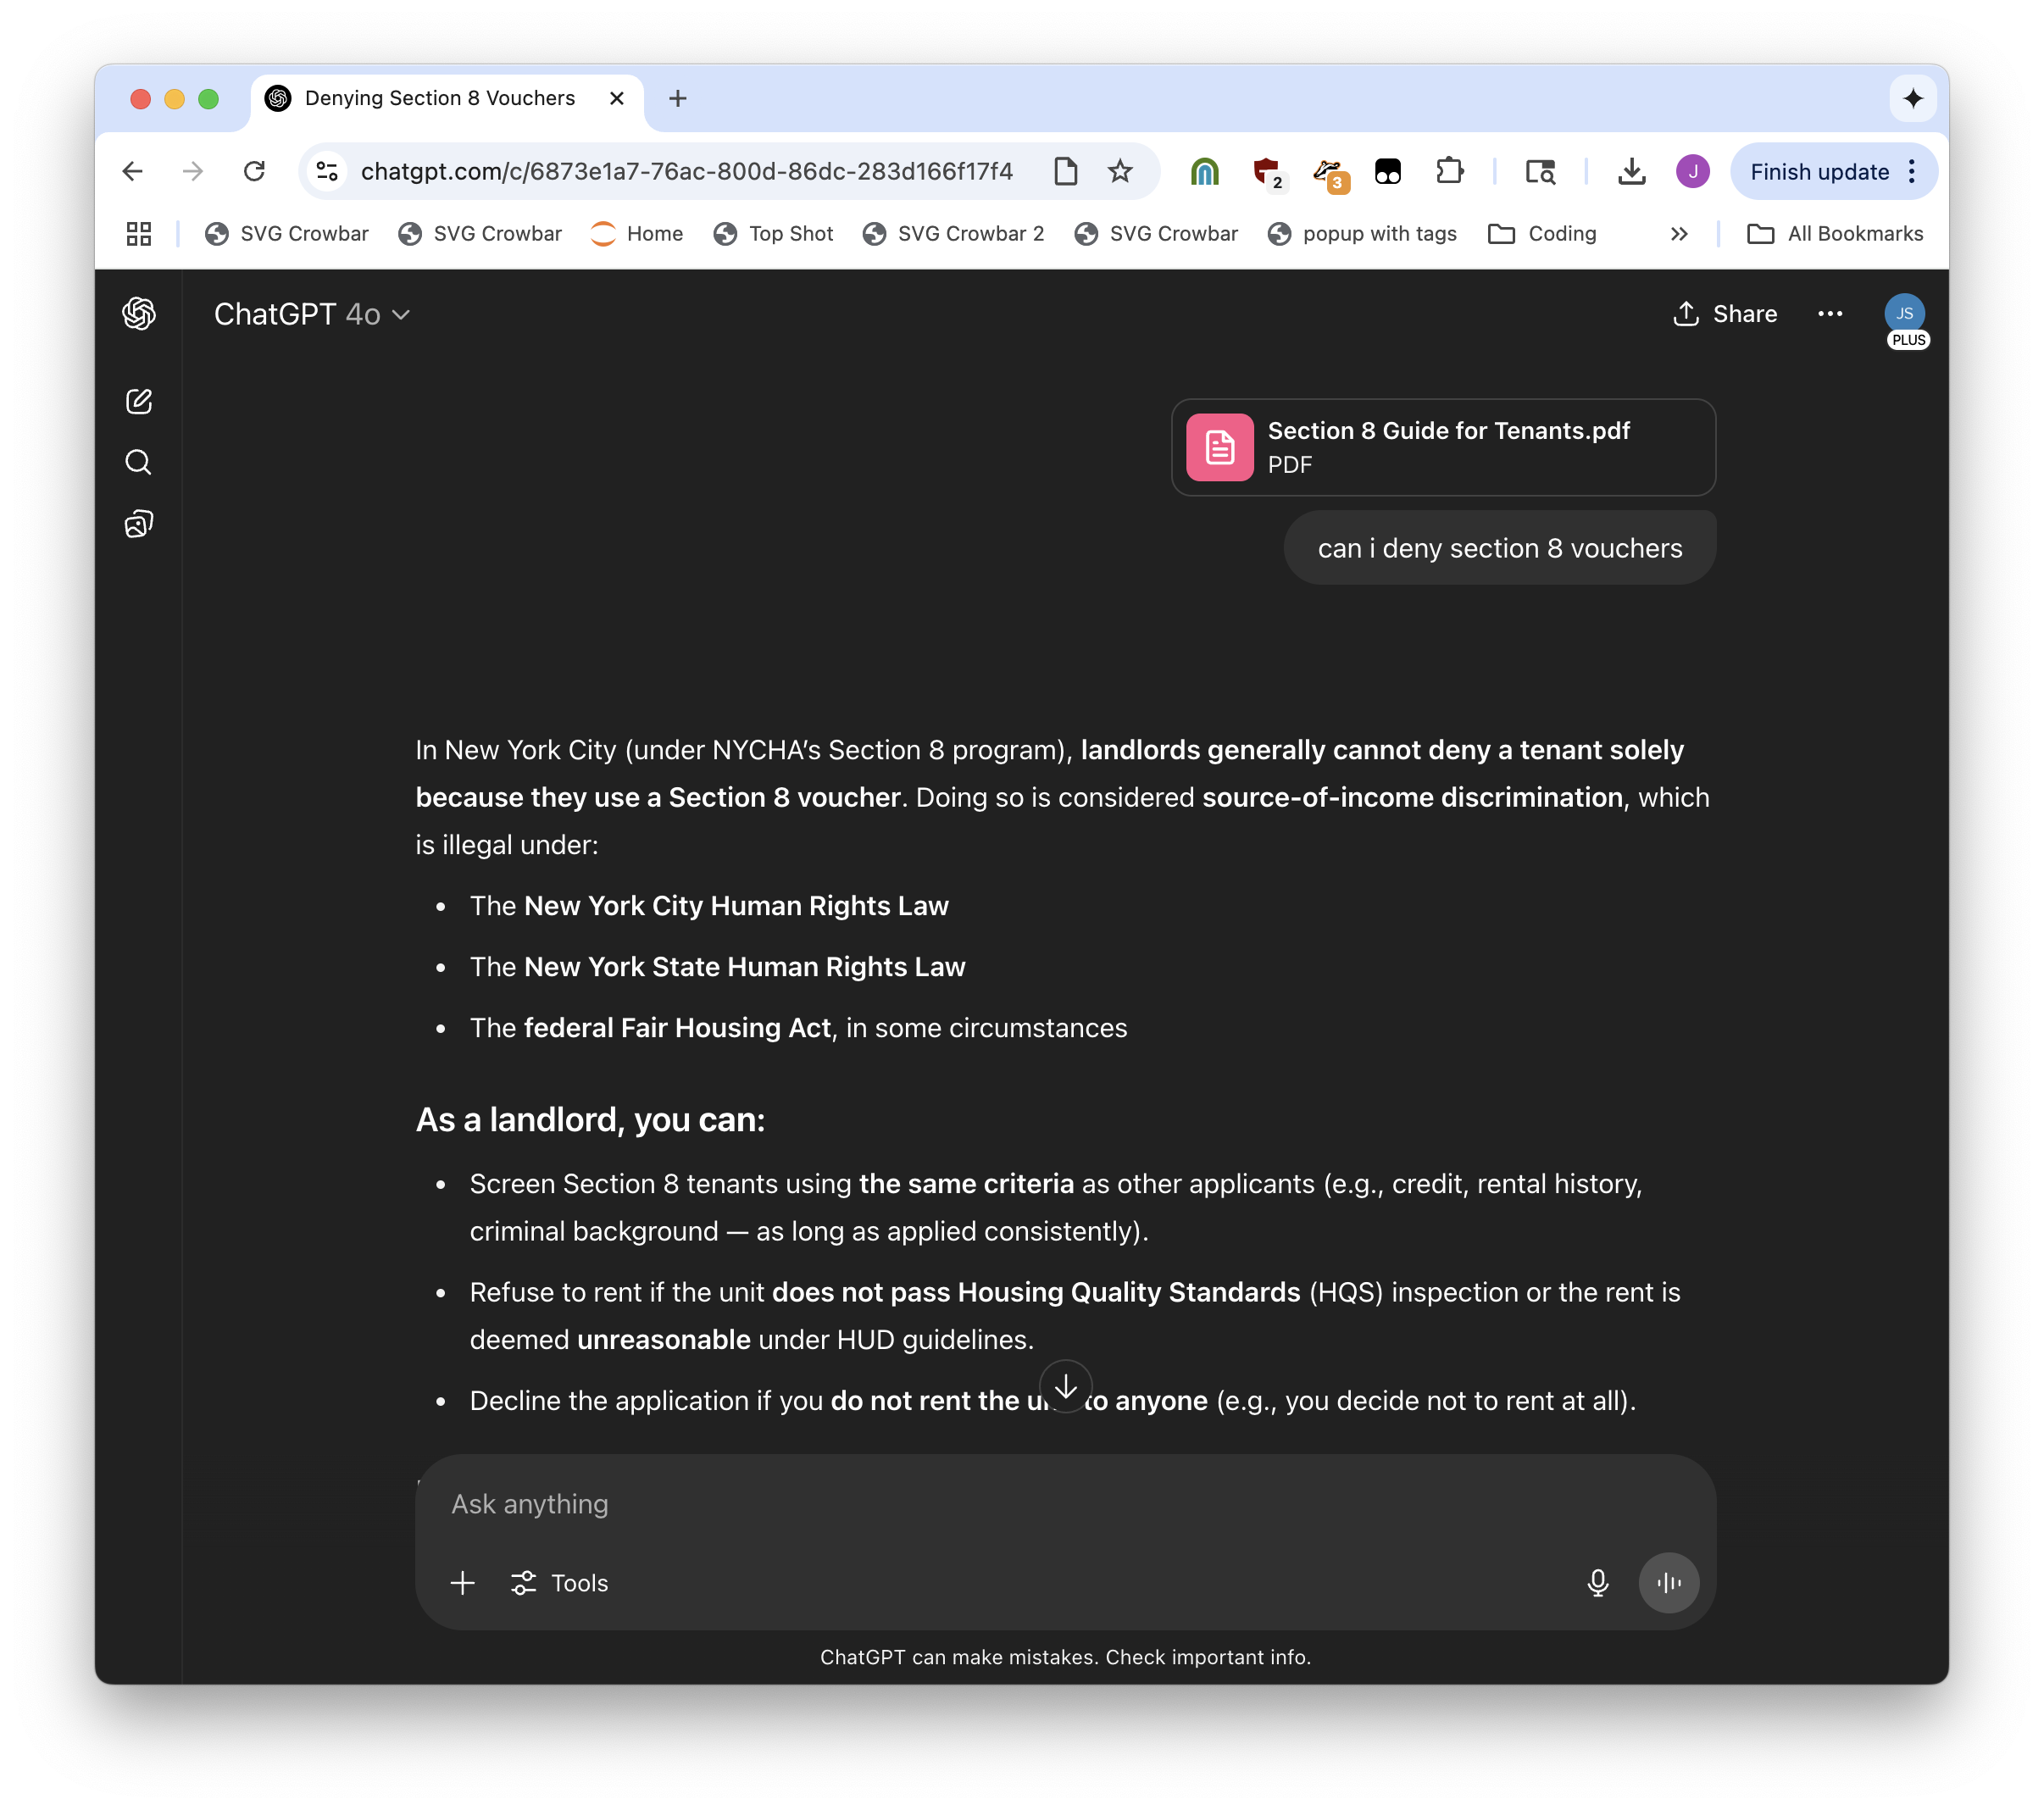

Slide 39
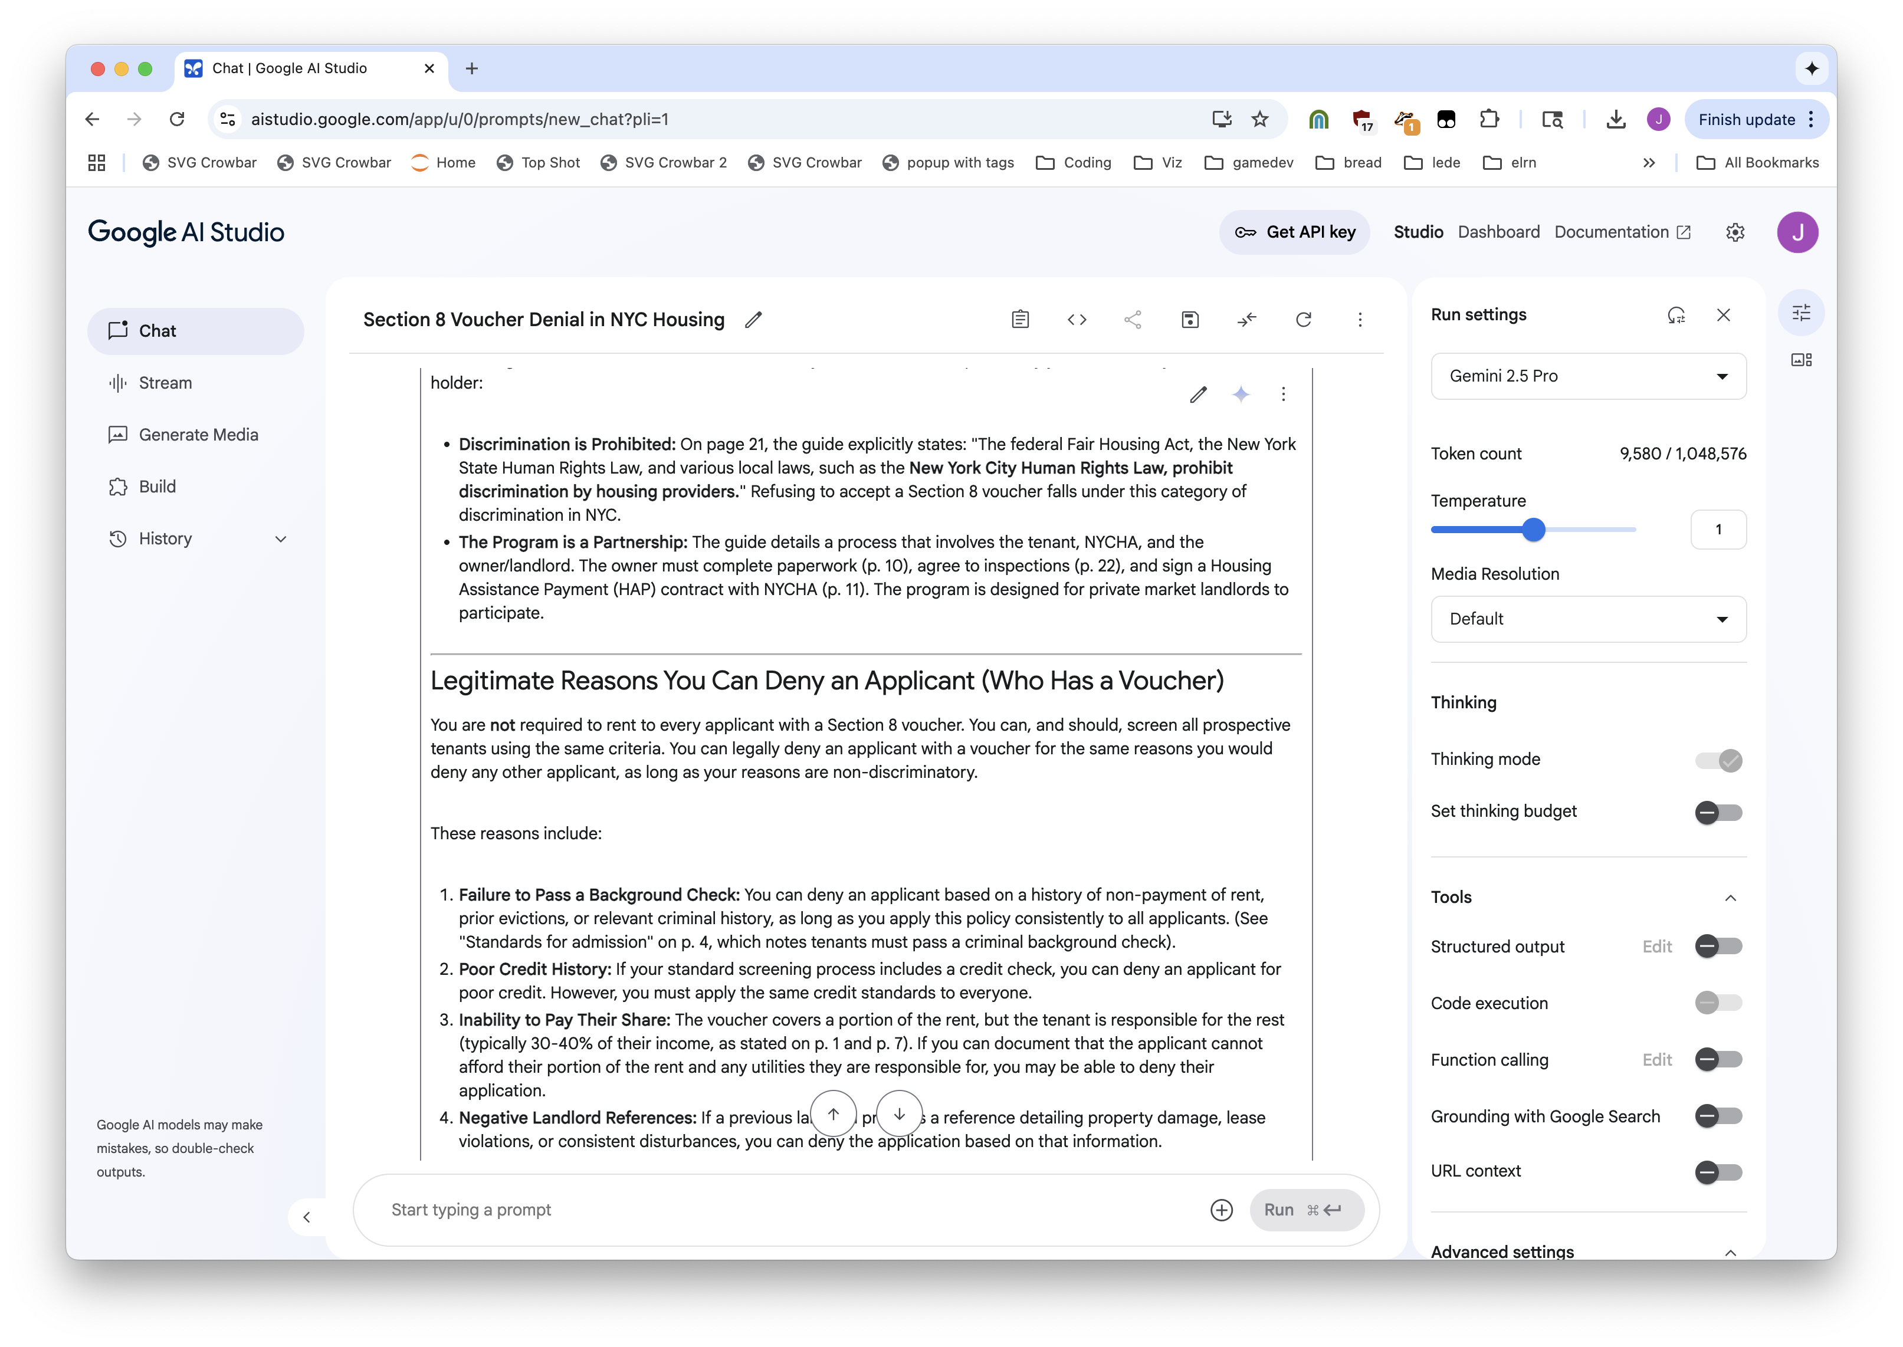


Slide 40
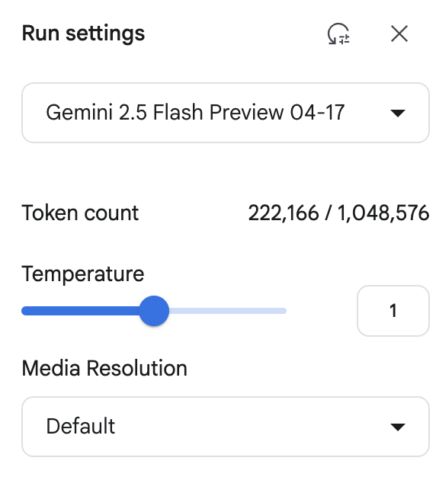
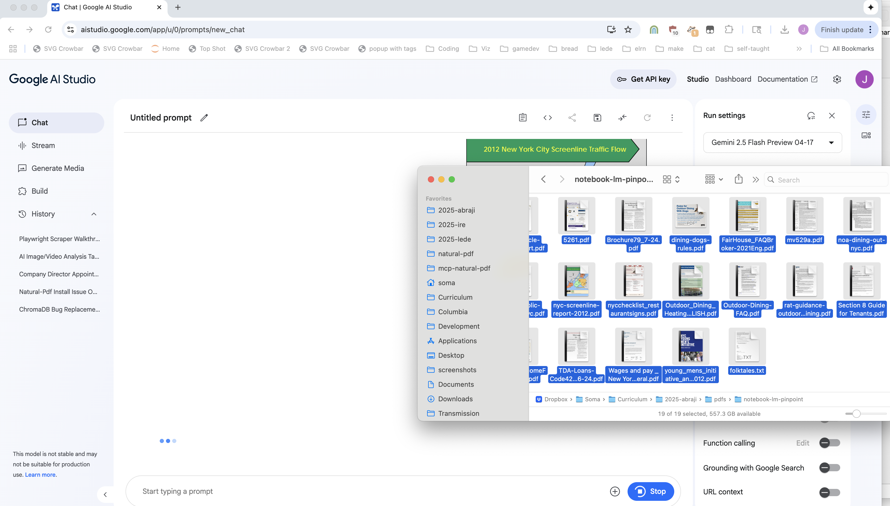


Slide 41
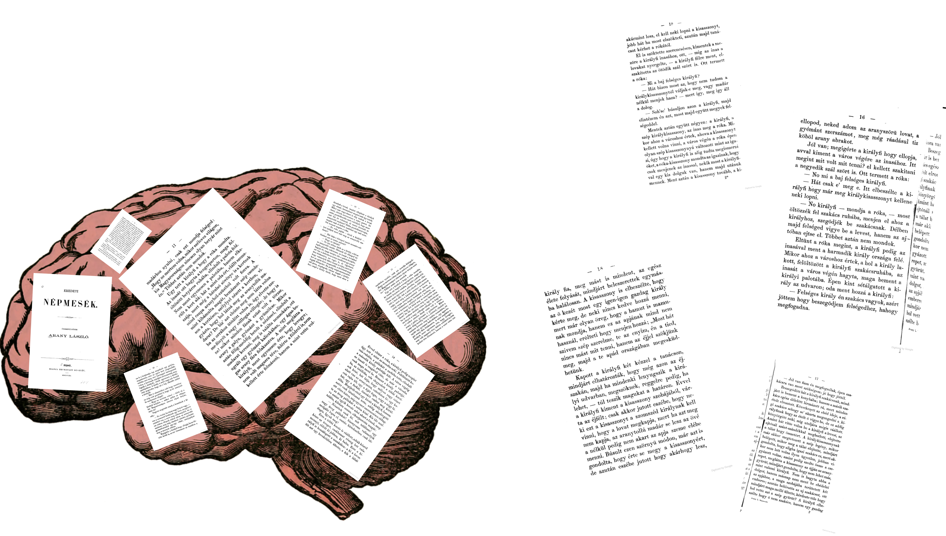

Context window

Slide 42
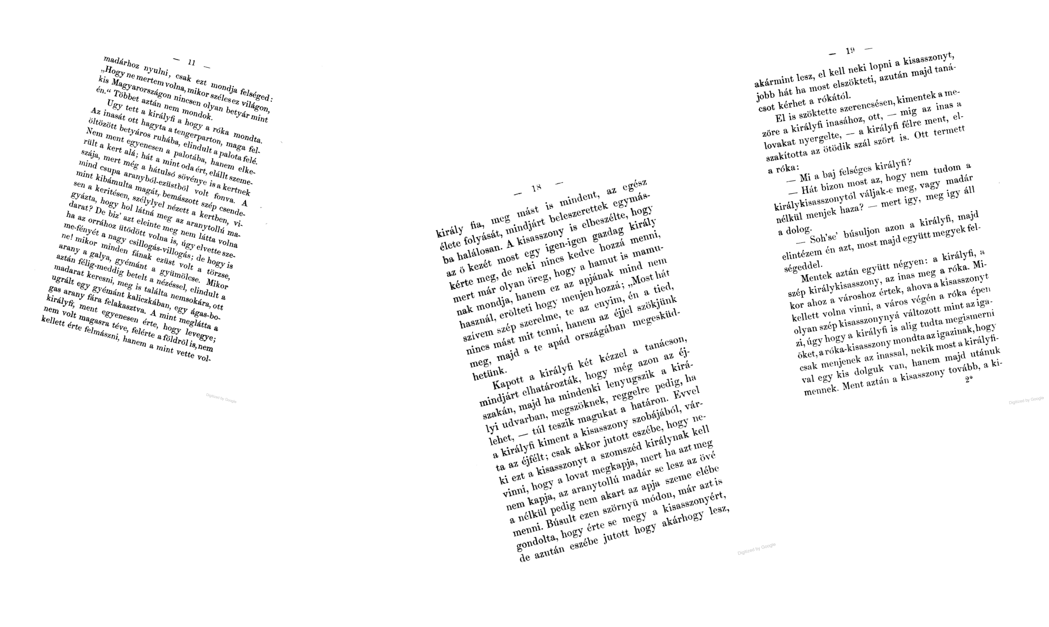



Slice up your document, send top relevant sections with your question

Slide 43








too much content!
what’s relevant?
“answer my question using these 4 sections”
response from AI

Slide 44


Slide 45




Slide 46


Slide 47


Slide 48

But for research: Pinpoint

Slide 49



Slide 50



Slide 51
…but!

Slide 52



Slide 53


Slide 54
The journalism workflow is not the same as the “general bunch of PDFs” workflow

Slide 55

Our PDF workflow is special and specific
Notes:
We value being exactly right
We have very few workflows

Slide 56




Visit https://bit.ly/abraji-pdfs, scroll down down down down down
open all these
Scraping PDFs with Python + Natural PDF
click all these to install

Slide 57


Slide 58


Visit https://bit.ly/abraji-pdfs, scroll down down down down down

Slide 59


Visit https://bit.ly/abraji-pdfs, scroll down down down down down

Slide 60

Visit https://bit.ly/abraji-pdfs, scroll down down down down down

Slide 61

Visit https://bit.ly/abraji-pdfs, scroll down down down down down

Slide 62

Visit https://bit.ly/abraji-pdfs, scroll down down down down down

Slide 63

Visit https://bit.ly/abraji-pdfs, scroll down down down down down

Slide 64
Visit https://bit.ly/abraji-pdfs, scroll down down down down down
open all these
click all these to install

Slide 65
Visit https://bit.ly/abraji-pdfs, scroll down down down down down
Interviewing the worst PDFs on the planet
Jonathan Soma
Knight Chair in Data Journalism
Columbia University
js4571@columbia.edu / @dangerscarf

Slide 66
The more accurate/tabular, the less LLMs are useful (kind of)
But the more general vibes-y the better an LLM is.

Slide 67
=LLM or =CLAUDEEXTRACT if it’s based on the text

Slide 68
Ask an LLM to make your PDF processing workflow engine

Slide 69
But no real text! Images of text! need OCR

Slide 70
One hundred OCR tools one hundred OCR abilities
Tesseract
Acrobat
Other things

Slide 71
You can sometimes trust LLMs, kind of. Everything makes mistakes, just different mistakes.

Slide 72
But especially not with tables. Cascading errors.

Slide 73
AI can be useful but again, lots of different tools not a single workflow… until natural PDF

Slide 74
Control how to find things, like scraping a web page

Slide 75
OCR with many different tools. What is the best? Just try them all.

Slide 76
Find tables through magic, then just loop through all of your PDFs.

Slide 77
Ask questions

Slide 78
Find tables

Slide 79
Find tables + OCR the tables individually

